Slide 1
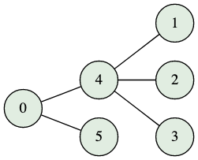
Graceful Labelings
Notes:
Today, I will be presenting my work on the graceful labeling conjecture. This conjecture was first introduced by Alexander Rosa in 1967. The reason for this conjecture is actually related to Ringel’s conjecture.

Slide 2
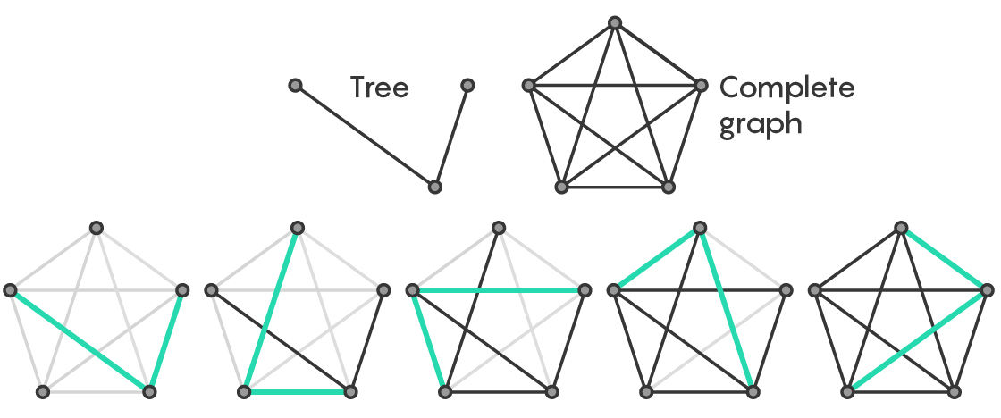
Ringel’s Conjecture
Notes:
Ringel’s conjecture states that for any n+1-vertex tree T, the complete graph K_{2n+1} can be decomposed into 2n+1 edge disjoint subgraphs isomorphic to T (where edge disjoint basically means that the edges do not overlap). This process can be seen in the image on this slide. In this image, n=2, we have a tree T with n+1=3 vertices, and we have the complete graph K_{2n+1=5}. We see that it is indeed possible to decompose the complete graph K_5 into 5 disjoint subgraphs isomorphic to T. Rosa proved that if a given tree T with n+1 vertices has a graceful labeling, then the complete graph K_{2n+1} can be decomposed into 2n+1 edge-disjoint isomorphic copies of T. Therefore, if the graceful labeling conjecture is proved, then Ringel’s conjecture would also be proved (although I believe that Ringel’s conjecture has already been proven). At first, graceful-labelings were actually referred to as Beta-valuations.

Slide 3
Definitions
G = (V(G), E(G))
deg(v) = # of edges incident to v
Trees = Special Connected Graph
Labeling of Tree: f: V(G) → {0,1,...,n-1}
Induced Edge Label of {u,v} = |f(u)-f(v)|
Graceful Labeling of Tree: E(G) ↔ {1,...,n-1}
Notes:
Here are some formal definitions and background information of the graceful labeling conjecture. First, we note that an arbitrary graph G can be thought of as an ordered pair (V(G), E(G)), where V(G) represents the set of vertices and E(G) represents the set of edges (which can be thought of as unordered sets containing two vertices). The valency or degree of a vertex v is the number of edges that are connected to v. Trees are a special kind of connected graph (connected graphs have a path between every pair of vertices) that do not contain cycles. A tree with n vertices has n-1 edges (this is fairly easy to prove by induction). A labeling of a tree is an injective function from the vertices to the integers 0 through n-1 (the injectivity implies that two distinct vertices must have different labels). The induced edge label of the edge {u,v} is equal to |f(u)-f(v)| (essentially just subtracting the labels of the vertices u and v). A graceful labeling of the tree has the added condition that all induced edge labels are distinct (which essentially implies that there is a bijection between the edge set and the numbers 1 through n-1).

Slide 4
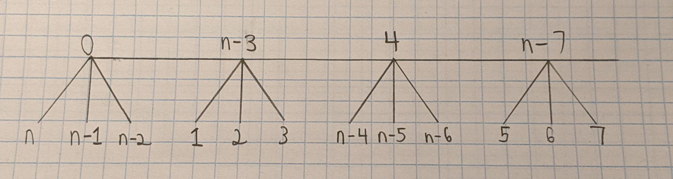
Caterpillar Graphs
Notes:
I first attempted to gracefully label a caterpillar graph whose vertices on the central path all had the same degree (which was three in this case). My attempt can be seen in this image. First, I labeled the leftmost central path vertex with 0, and I then labeled the three 1-distant vertices below it with n, n-1, and n-2 (to obtain the largest edge labels). I then labeled the next vertex on the central path with n-3, and I labeled the vertices below it with 1,2,3. Essentially, I tried to obtain all of the edge labels in descending order. This seemed to work fairly well.

Slide 5
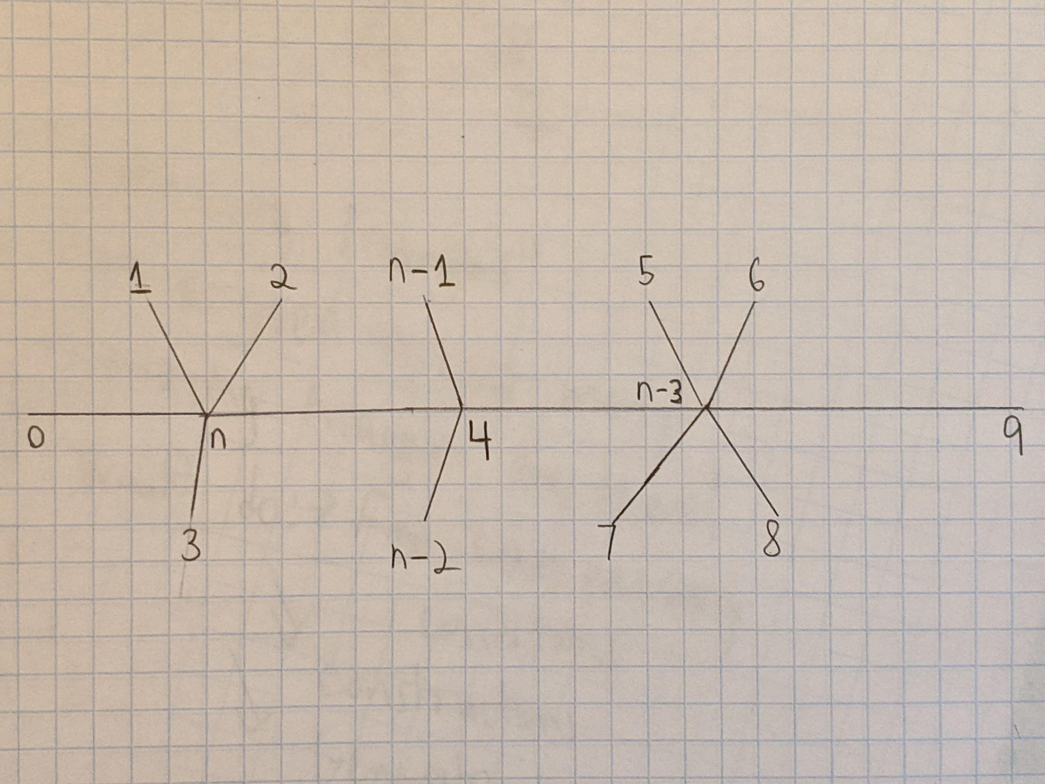
Caterpillar Graphs (Cont.)
Notes:
Here, I attempted to generalize the previous technique of gracefully labeling the caterpillar graph so that it would work for a caterpillar graph whose central path vertices had arbitrary degrees. First, I decided to label the leftmost vertex with 0, and I decided to label the vertex immediately next to it with n (in order to obtain the largest edge label). I then placed the lowest remaining vertex labels on the vertices adjacent to the vertex labeled with n. In fact, this is actually necessary. To see why, let us examine the edge label of n-1. The only way that we could get such an edge label would be by pairing the labels n-1 and 0 (which is impossible because all of the vertices adjacent to 0 have already been labeled) or by pairing the labels n and 1. Similar reasoning applies for the case of n-2, n-3, and n-4. It is also crucial that we place the label 4 (the highest available label of the lowest available labels) on the next central path vertex. If we did not do this, then when we place the next highest remaining vertex labels (such as n-1) adjacent to third central path vertex, we would get repeated edge labels (such as n-4). Similarly, we must place the label n-3 on the next central path vertex.

Slide 6
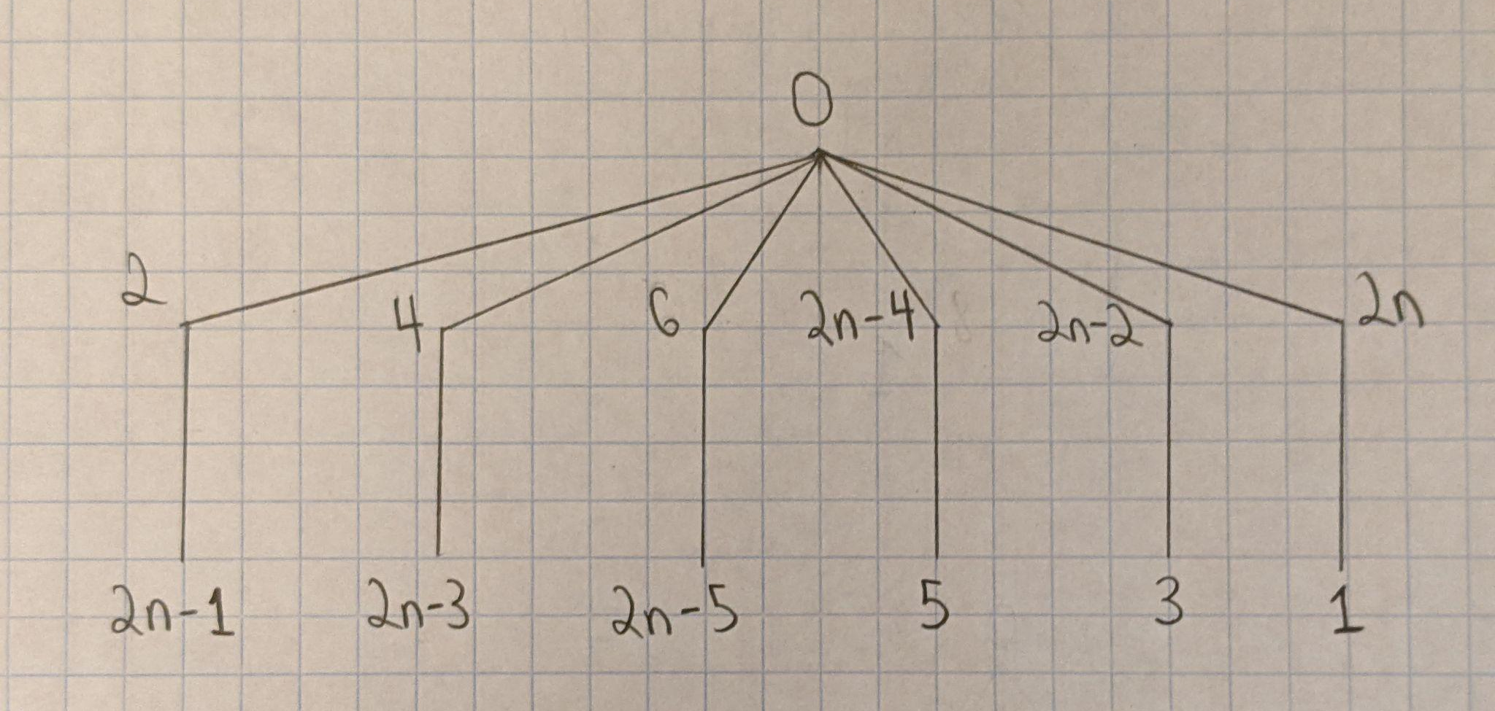
Symmetrical Trees
Notes:
Although the title of this slide is “Symmetrical Trees”, it is important to note that the trees on this slide are only a special kind of symmetrical tree, not all of the symmetrical trees. First, I tried labeling special symmetrical trees with exactly two layers. In order to label this tree, I first labeled the root vertex with 0. I then labeled the vertices on the first layer with all of the even numbers. Because the root vertex had a label of 0, this would ensure that the edges on the first layer obtained all of the even labels. Also, I had to label all of the vertices on the second layer with the odd labels (which would give me all of the odd edge labels). Furthermore, I had to go in ascending order when labeling all of the vertices on the first layer with even numbers, and I had to go in descending order when labeling all of the vertices on the second layer with odd numbers. By using the ascending and descending order technique, I would ensure that I did not obtain repeated odd edge labels. For each edge, we essentially go down by 2, which ensures that we will obtain all of the distinct odd edge labels.

Slide 7
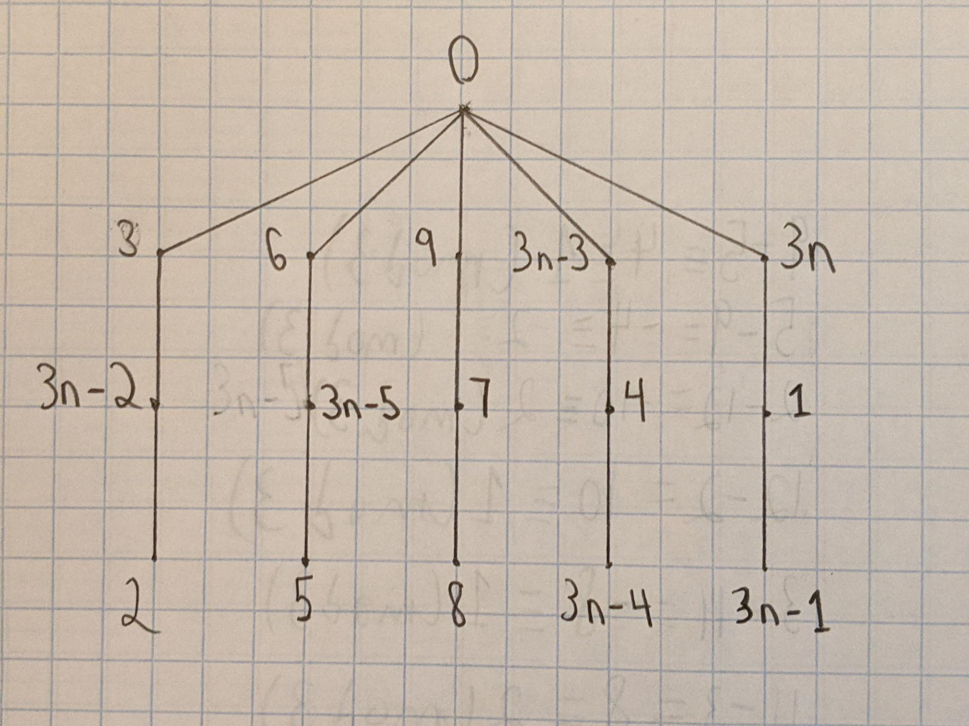
Symmetrical Trees (Cont.)
Notes:
On this tree, I utilized a similar trick. After labeling the root vertex with 0, I labeled all of the vertices on the first layer with numbers that are congruent to 3 modulo 3 (which is also technically 0 modulo 3). On the second layer, I labeled all of the vertices with numbers that are congruent to 1 modulo 3. On the final layer, I labeled all of the vertices with numbers that are congruent to 2 modulo 3. Once again, for each layer, we alternate between labeling the vertices in ascending order and descending order. This again gives us distinct edge labels.

Slide 8
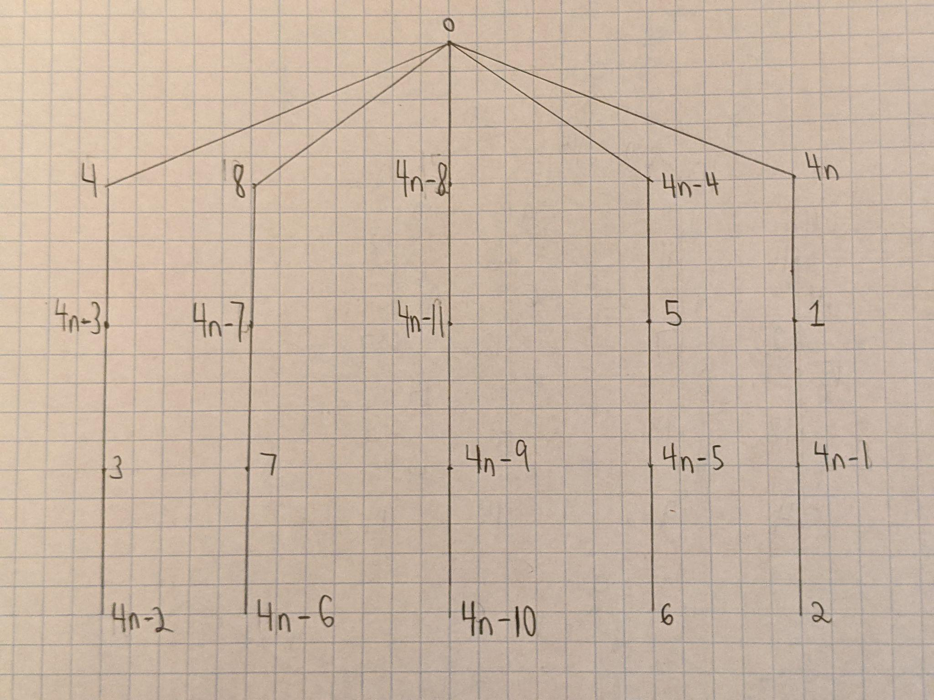
Symmetrical Trees (Cont.)
Notes:
We again used a similar trick on the trees with four layers. On the first layer, I labeled all of the vertices with the numbers that are congruent to 4 modulo 4 (0 modulo 4). On the second layer, I labeled all of the vertices with the numbers that are congruent to 1 modulo 4. On the third layer, I labeled all of the vertices with numbers that are congruent to 3 modulo 4. On the final layer, I labeled all of the vertices with numbers that are congruent to 2 modulo 4. If we look at the emerging pattern, we first realize that we must always alternate between labeling the vertices in ascending and descending order on different layers. Also, we realize that on the first layer we label all of the vertices with the numbers that are congruent to the largest number modulo 4, on the second layer we switch to labeling with the numbers that are congruent to the smallest number modulo 4, on the third layer we again switch to labeling with the numbers that are congruent to the highest remaining number modulo 4, and on the final layer we switch to labeling the vertices with the lowest remaining numbers modulo 4.

Slide 9
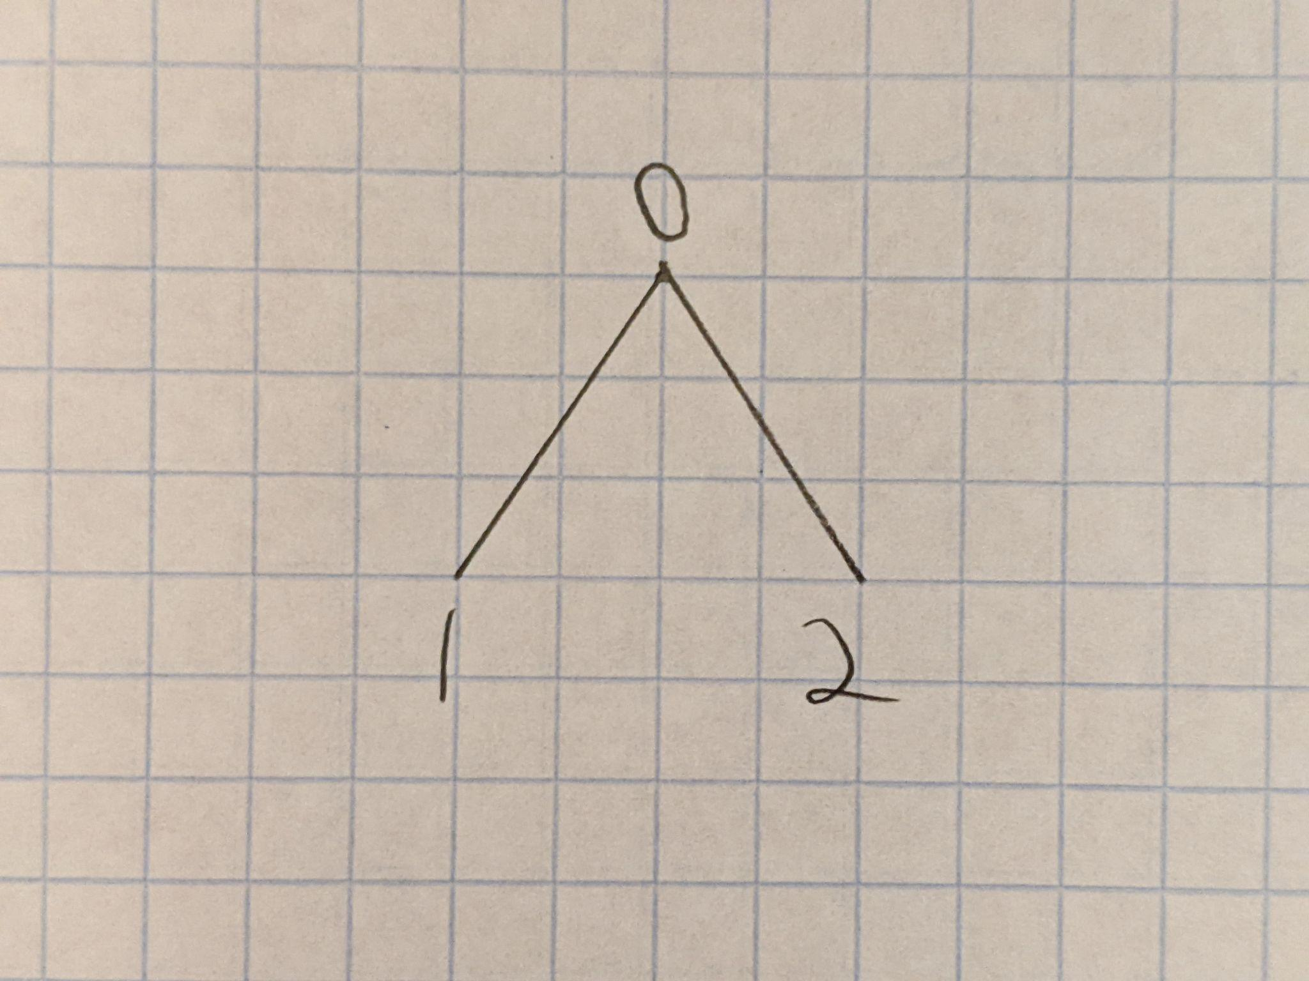
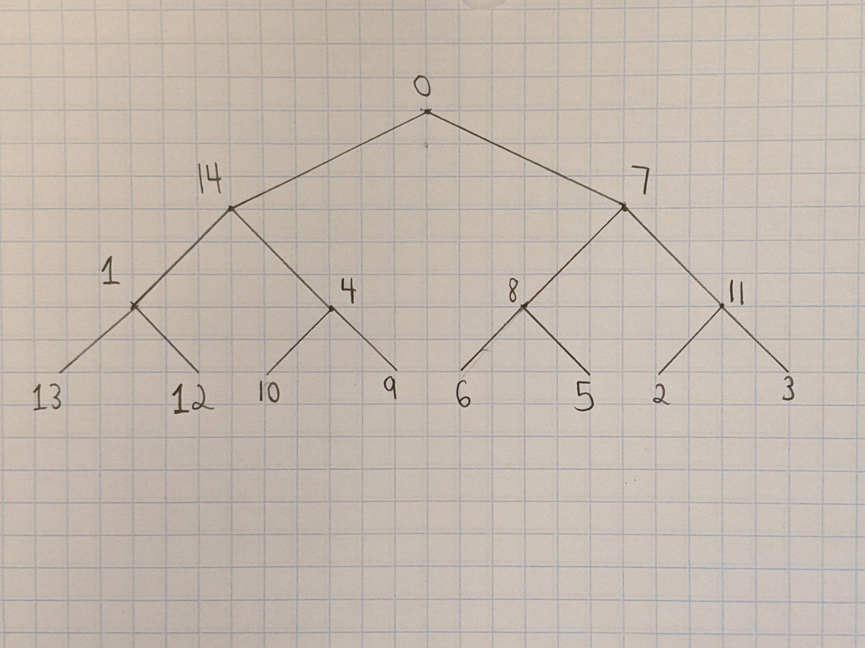
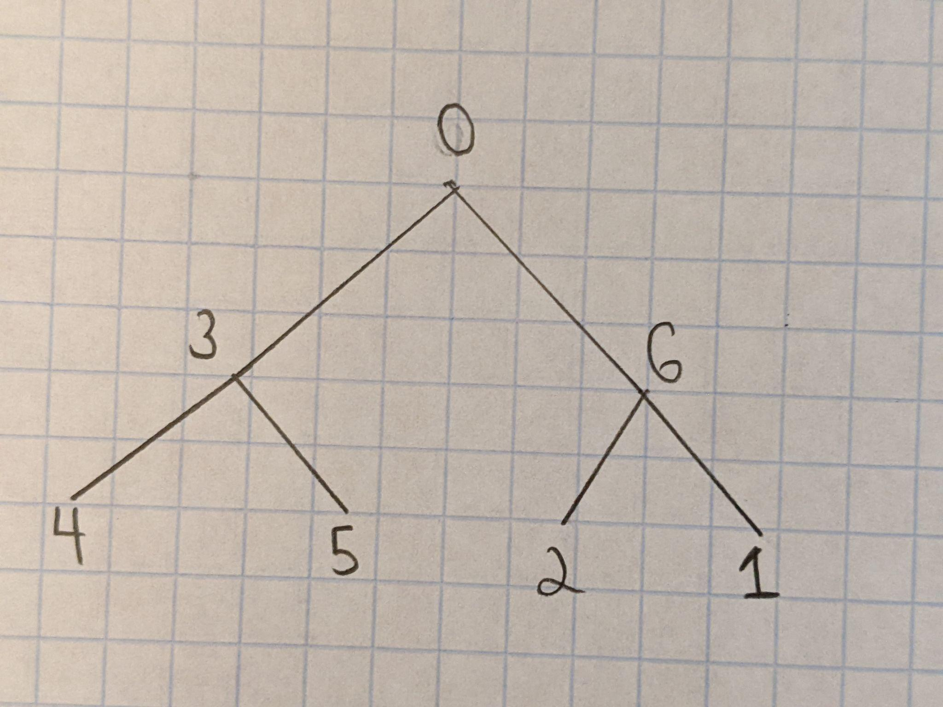
Binary Trees
Notes:
Here are some examples of my labeling binary trees. We notice that all of these trees have the root vertex labeled with 0 (which is not necessary). However, I was not really able to find a systematic method for gracefully labeling these binary trees. After spending many hours on this, I decided to research other people’s work.

Slide 10
Inductive Binary Trees
Notes:
After doing some research on the internet, I found a way to inductively gracefully label the binary trees (although the proof was used for more general symmetrical trees). I will demonstrate this technique by going from one gracefully labeled binary tree to the next larger gracefully labeled binary tree. First, we will start with the simplest non trivial gracefully labeled binary tree (notice that the root vertex is labeled with 0).

Slide 11
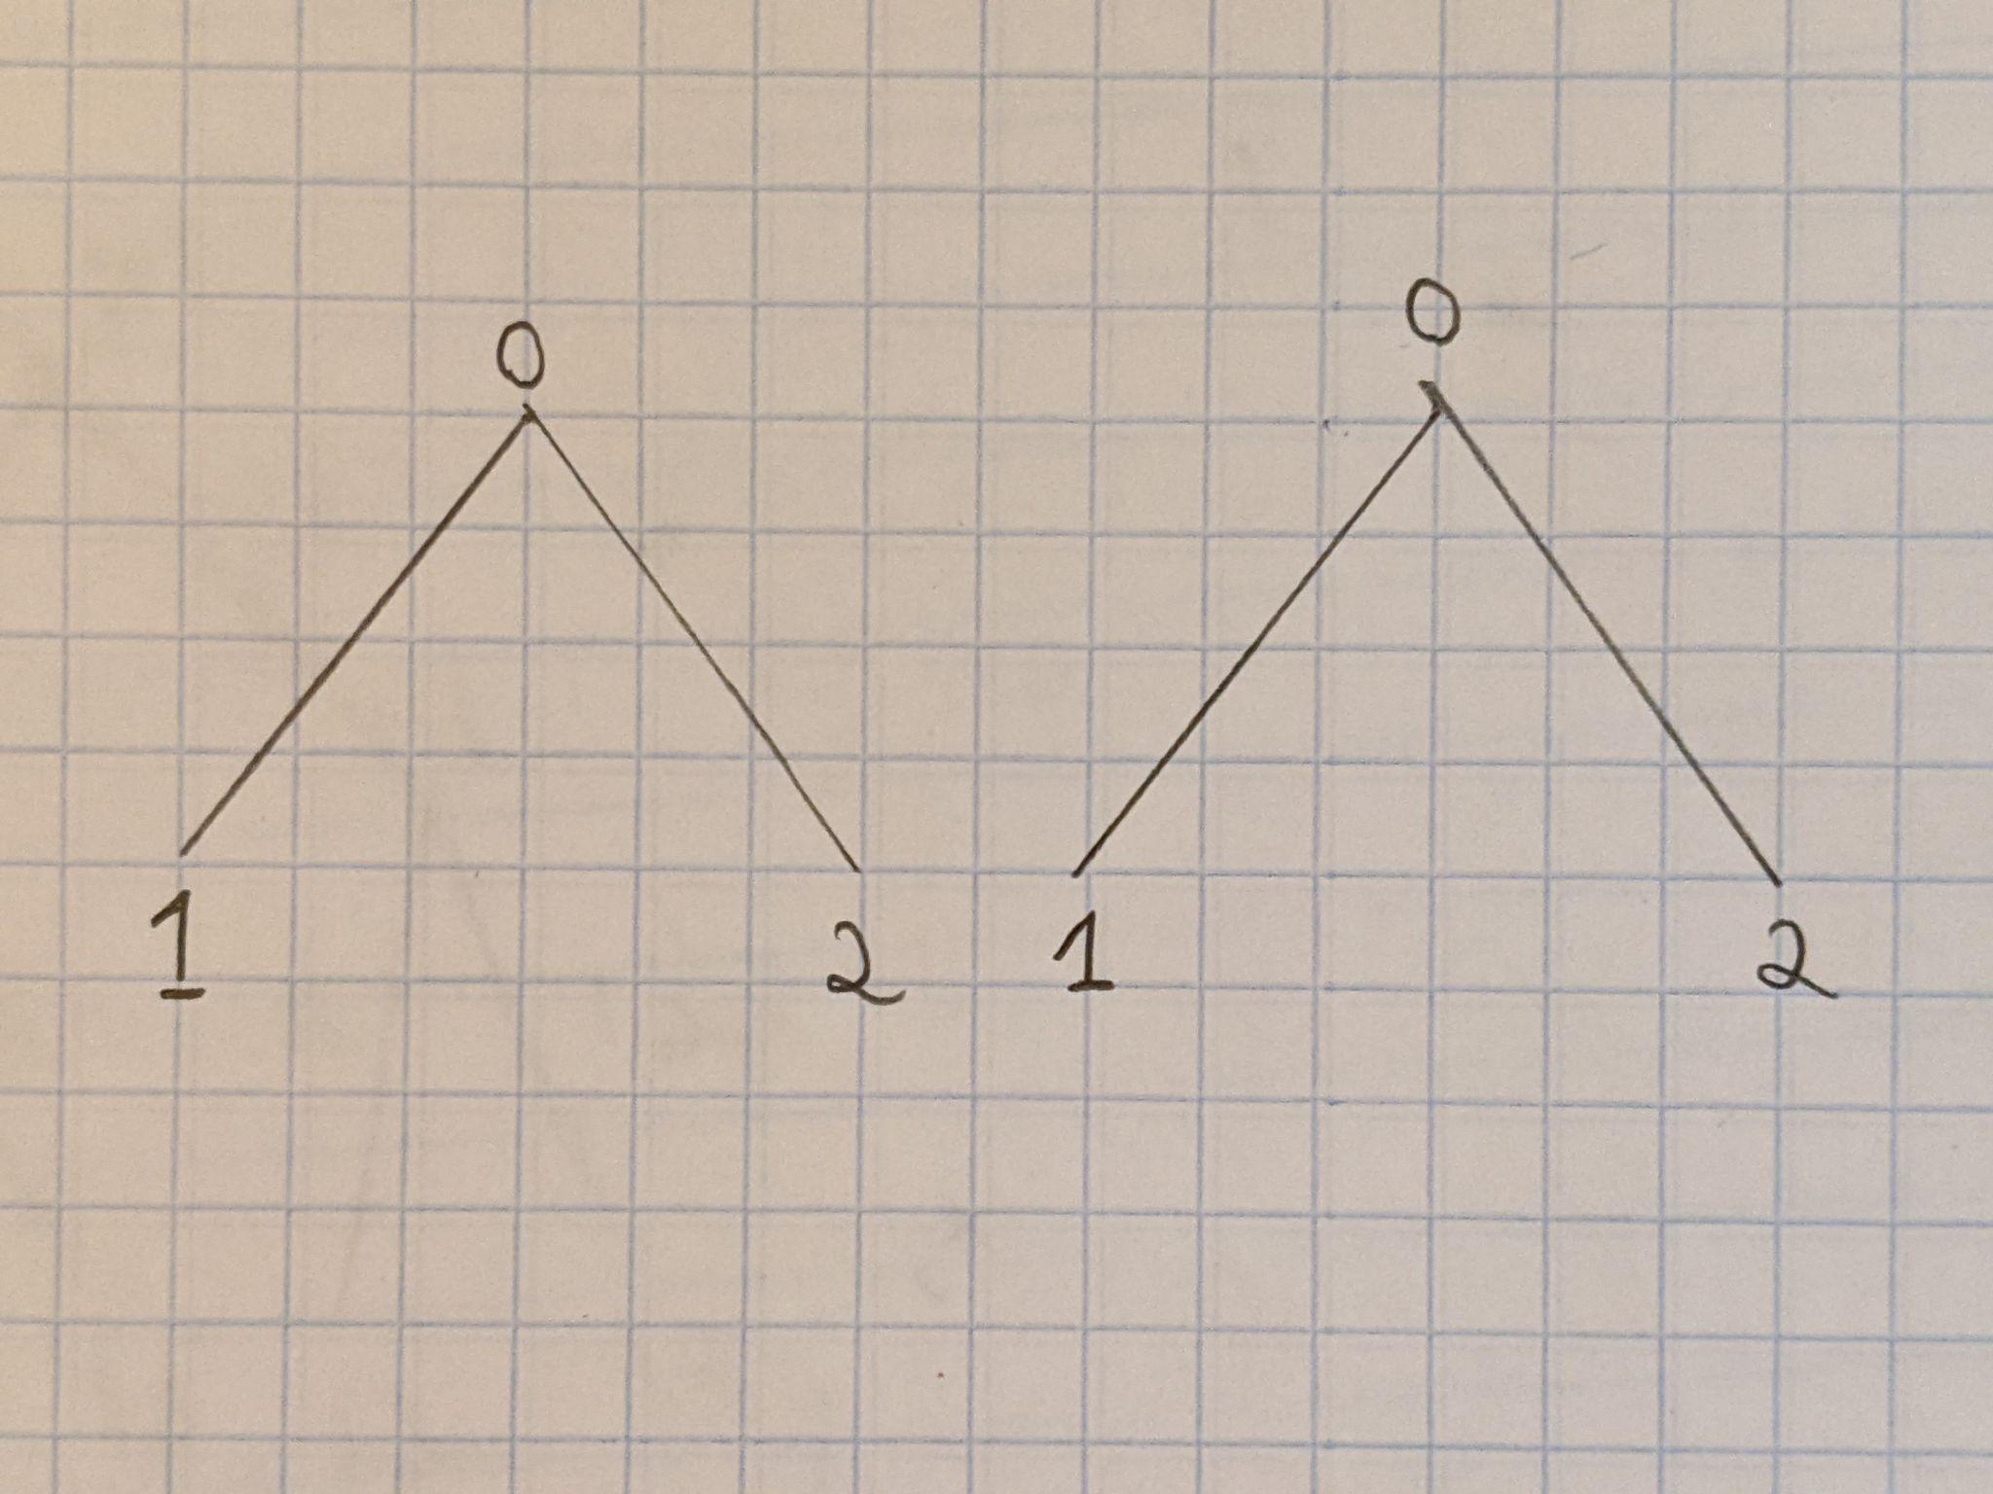
Inductive Binary Trees (Cont.)
Notes:
Then, we can create another copy of the simple gracefully labeled binary tree.

Slide 12
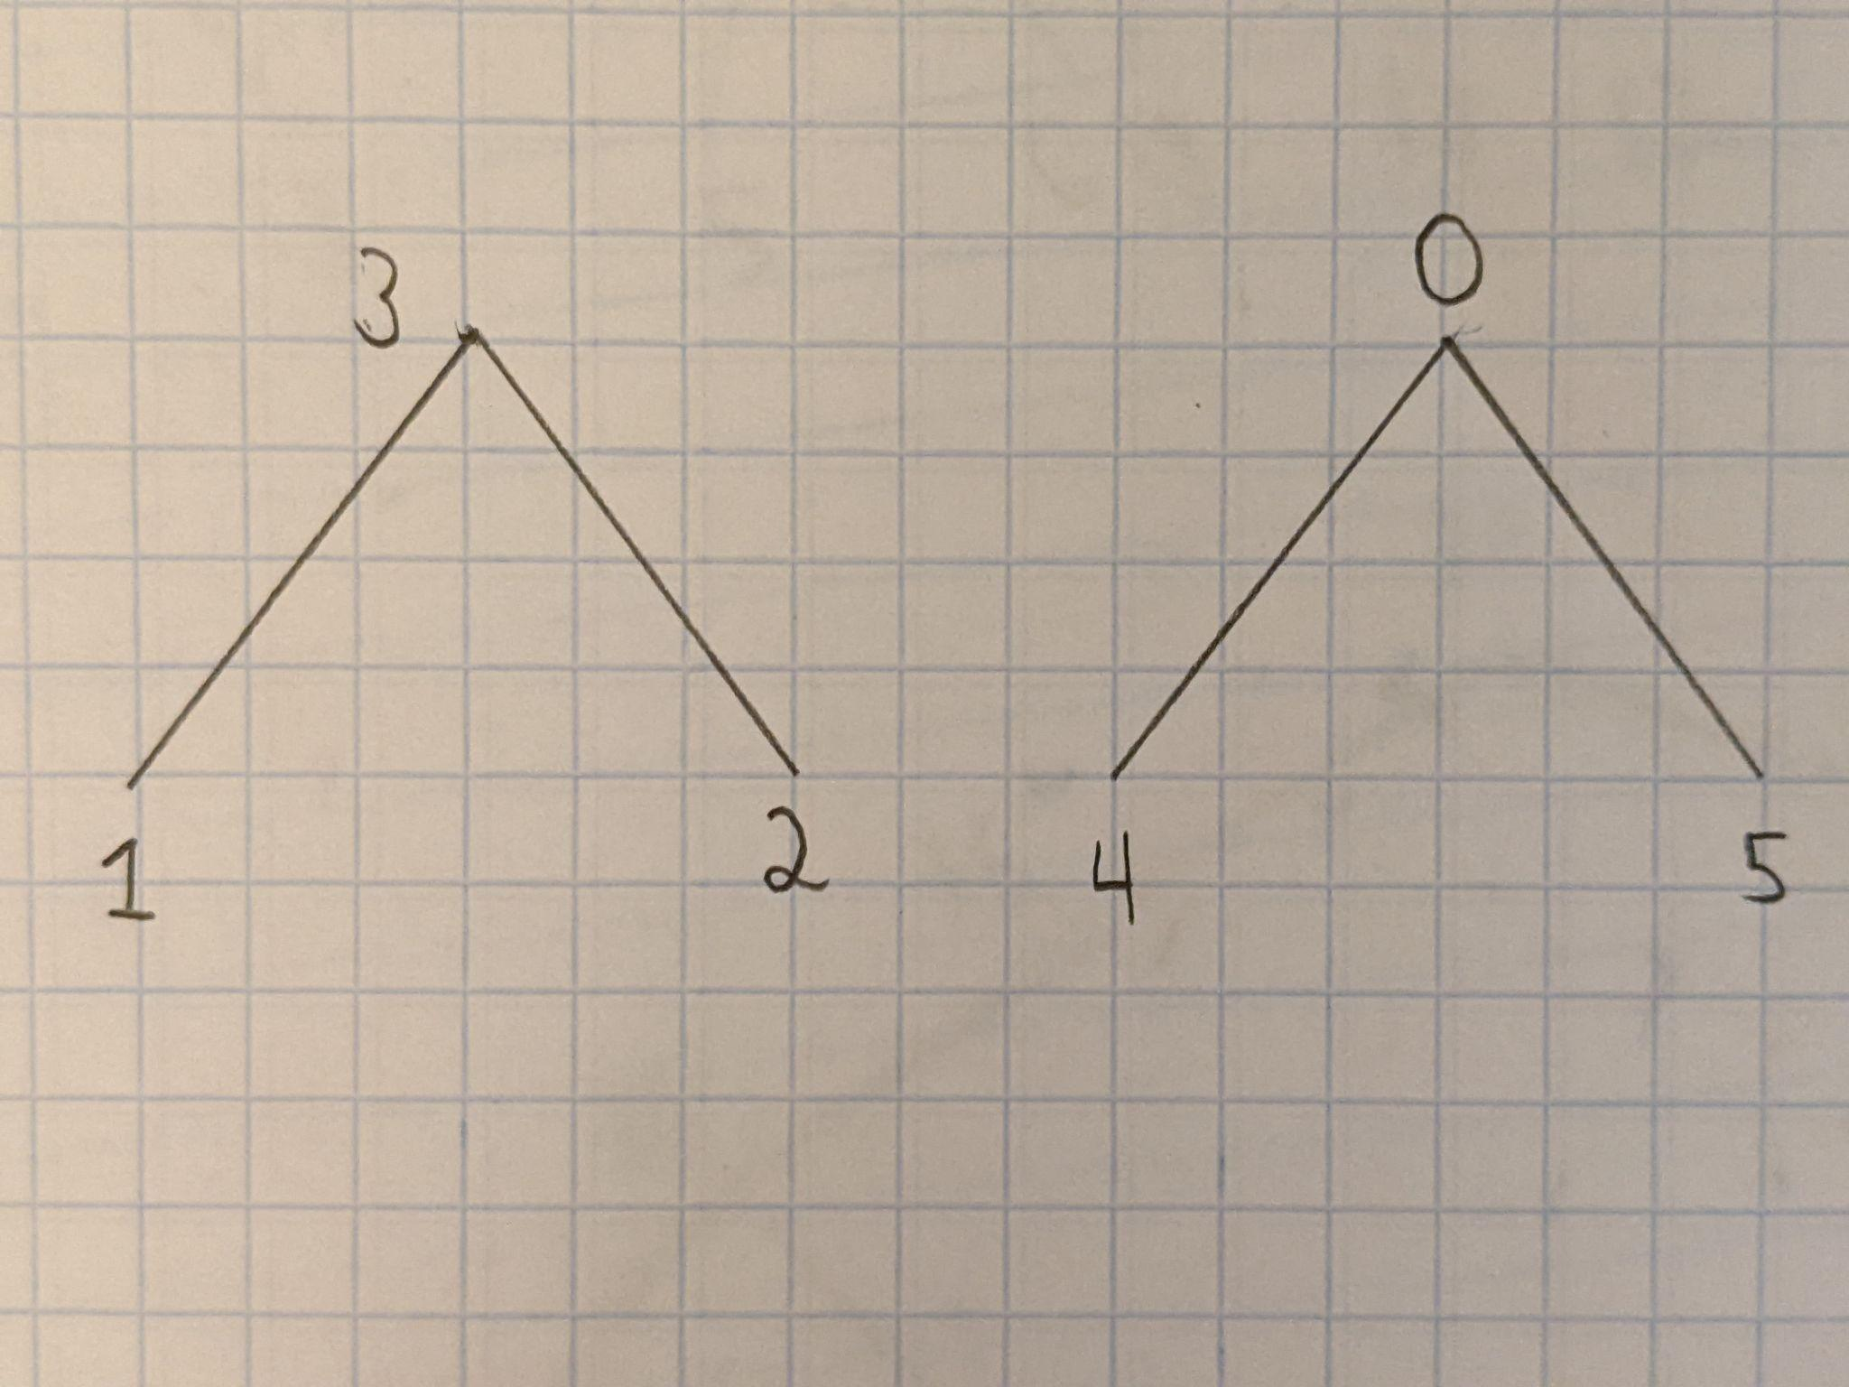
Inductive Binary Trees (Cont.)
Notes:
Let n=3 denote the number of vertices in each subtree. Starting on the first layer, we add 3 to the leftmost root vertex and 0 to the rightmost root vertex. Moving onto the next layer, we add 3 to the rightmost vertices, and we add 0 to the leftmost vertices. If there were more layers, then we would continue alternating between adding n to the leftmost and rightmost vertices. This will ensure that we obtain distinct vertex and edge labels.

Slide 13
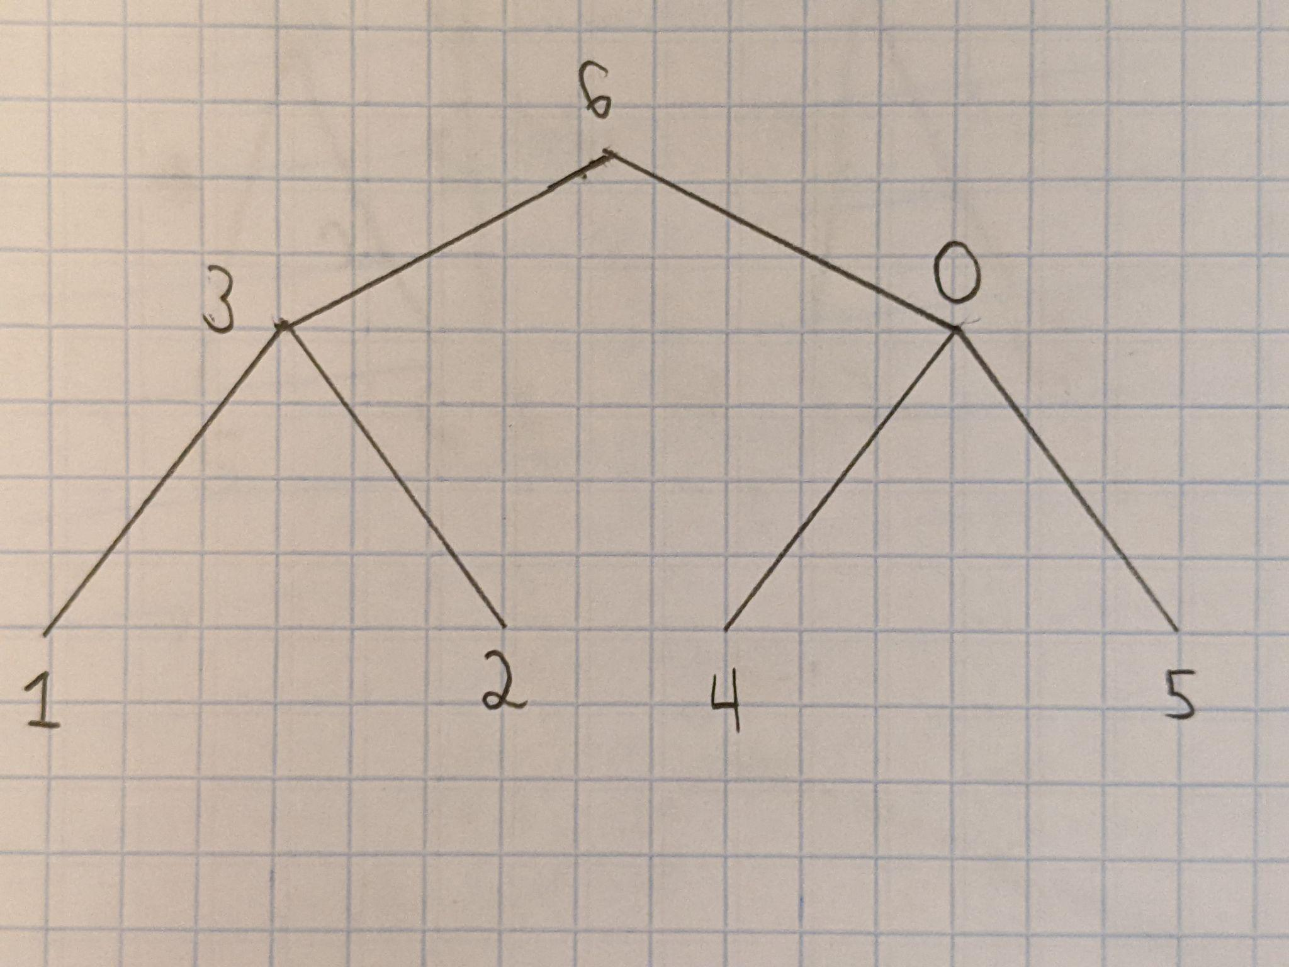
Inductive Binary Trees (Cont.)
Notes:
Finally, we add the root vertex, and we label it with the smallest unused positive integer in order to obtain the next larger gracefully labeled binary tree.

Slide 14
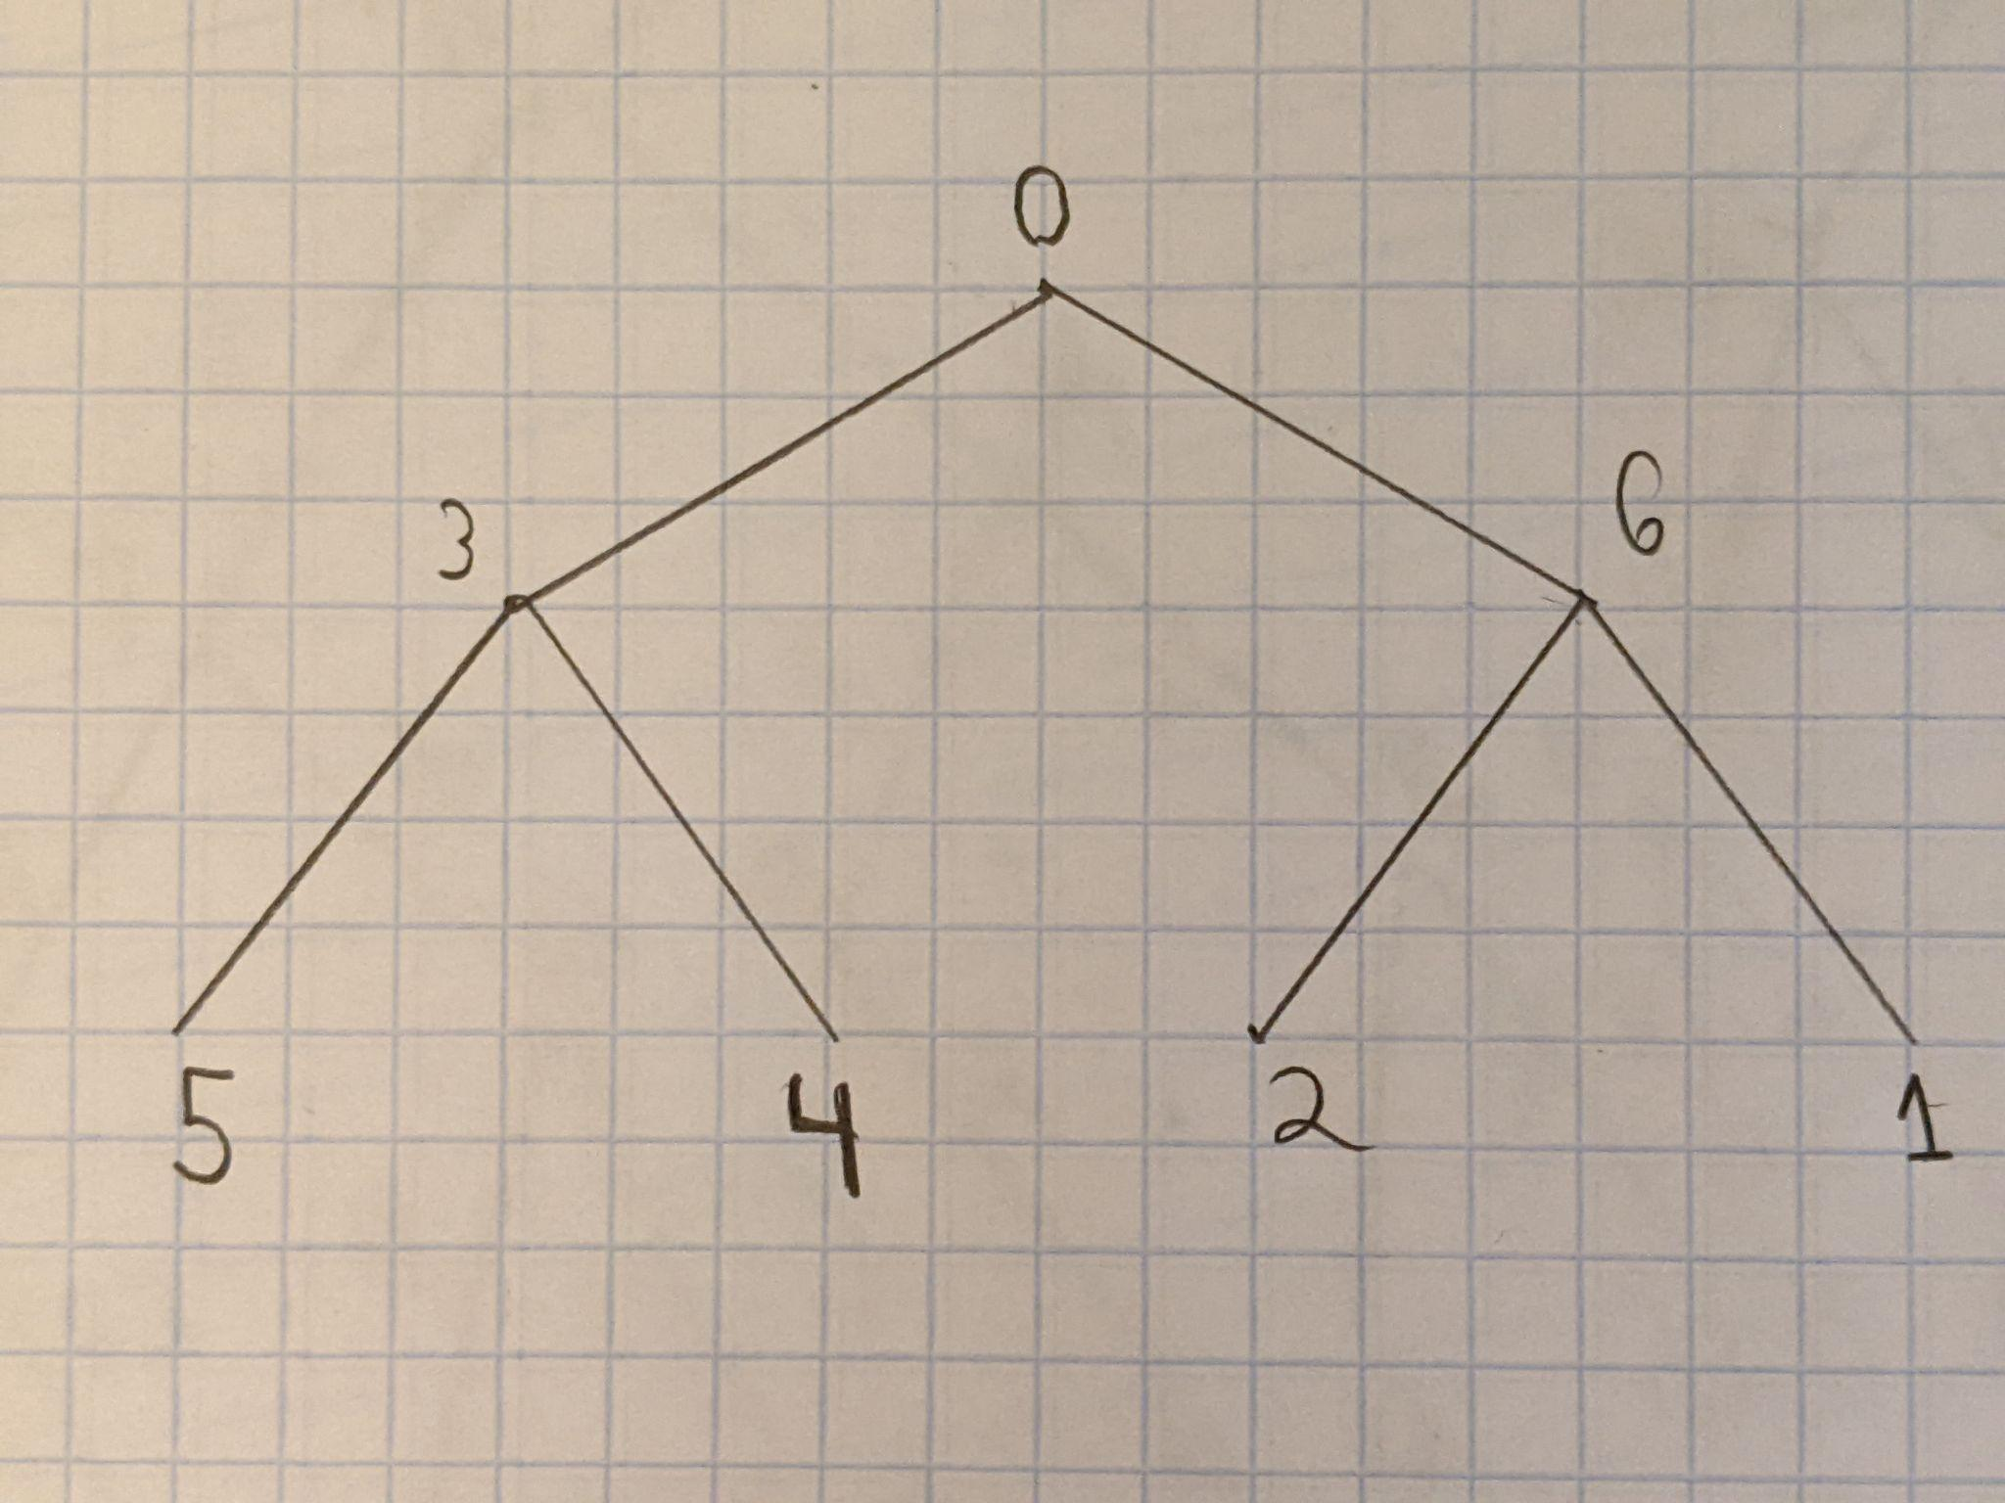
Inductive Binary Trees (Cont.)
Notes:
Here, we just take the complementary labeling of the previous gracefully labeled binary tree (which essentially means that we subtract every vertex label from the highest vertex label). The reason why we take the complementary labeling is so that the root vertex will still be labeled with 0 for the next inductive step.

Slide 15
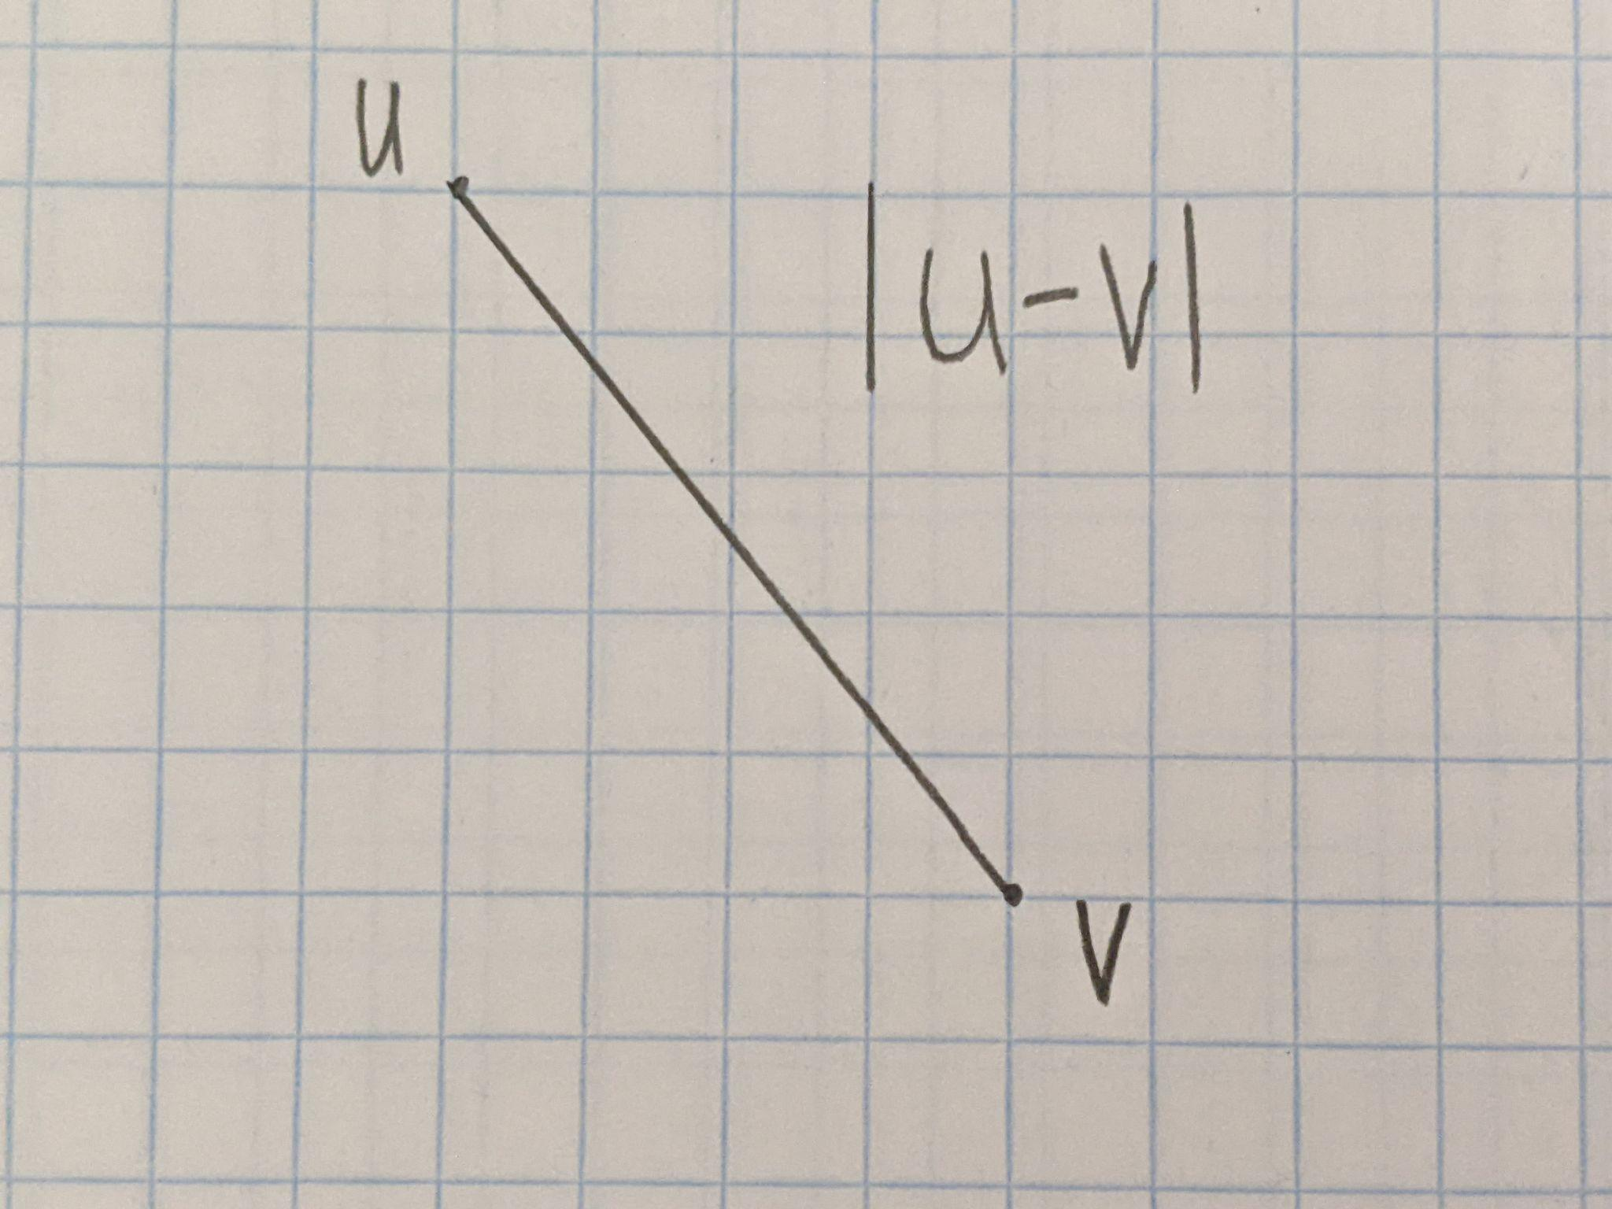
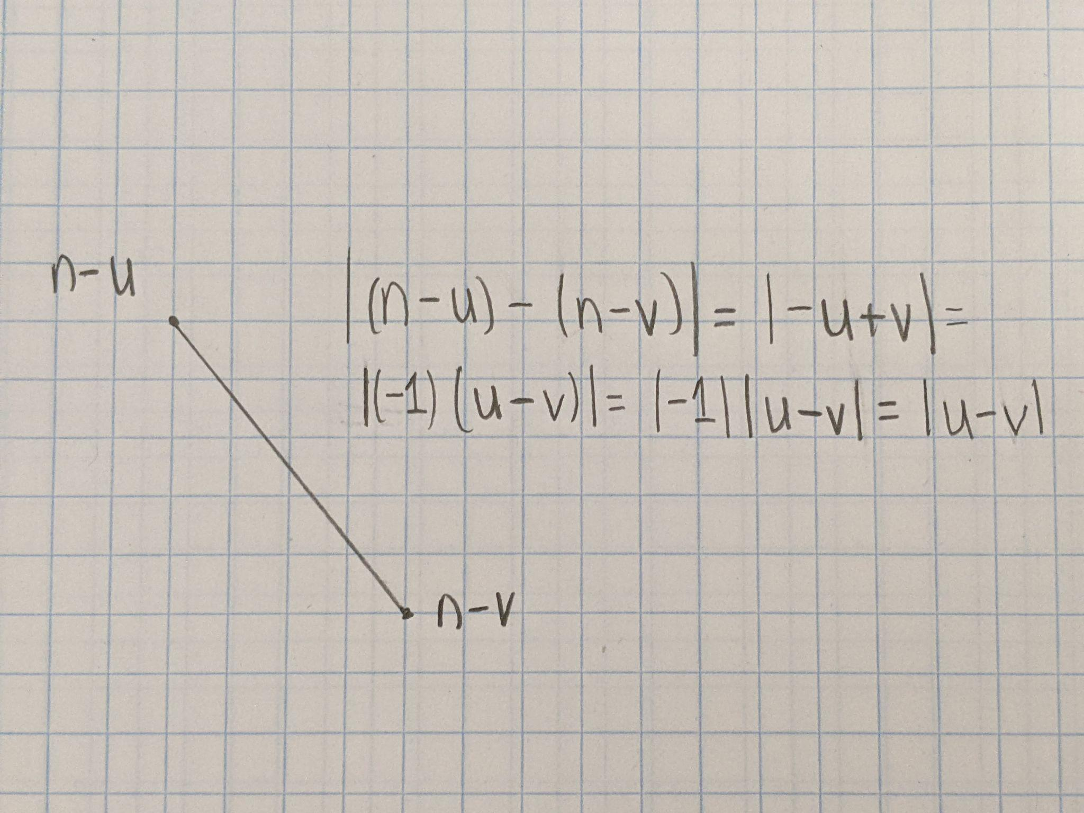
Complementary Labelings
Notes:
Here, I will illustrate the concept of complementary labelings. On the leftmost graph, we have two vertices that are labeled with the numbers u and v, and the induced edge label is |u-v| (their absolute difference). If we subtract both vertex labels from n (which denotes the highest vertex label), then we will still obtain the same edge labels. Since the original edge labels were already distinct, the new edge labels will also be distinct, thereby giving us a new graceful labeling.

Slide 16
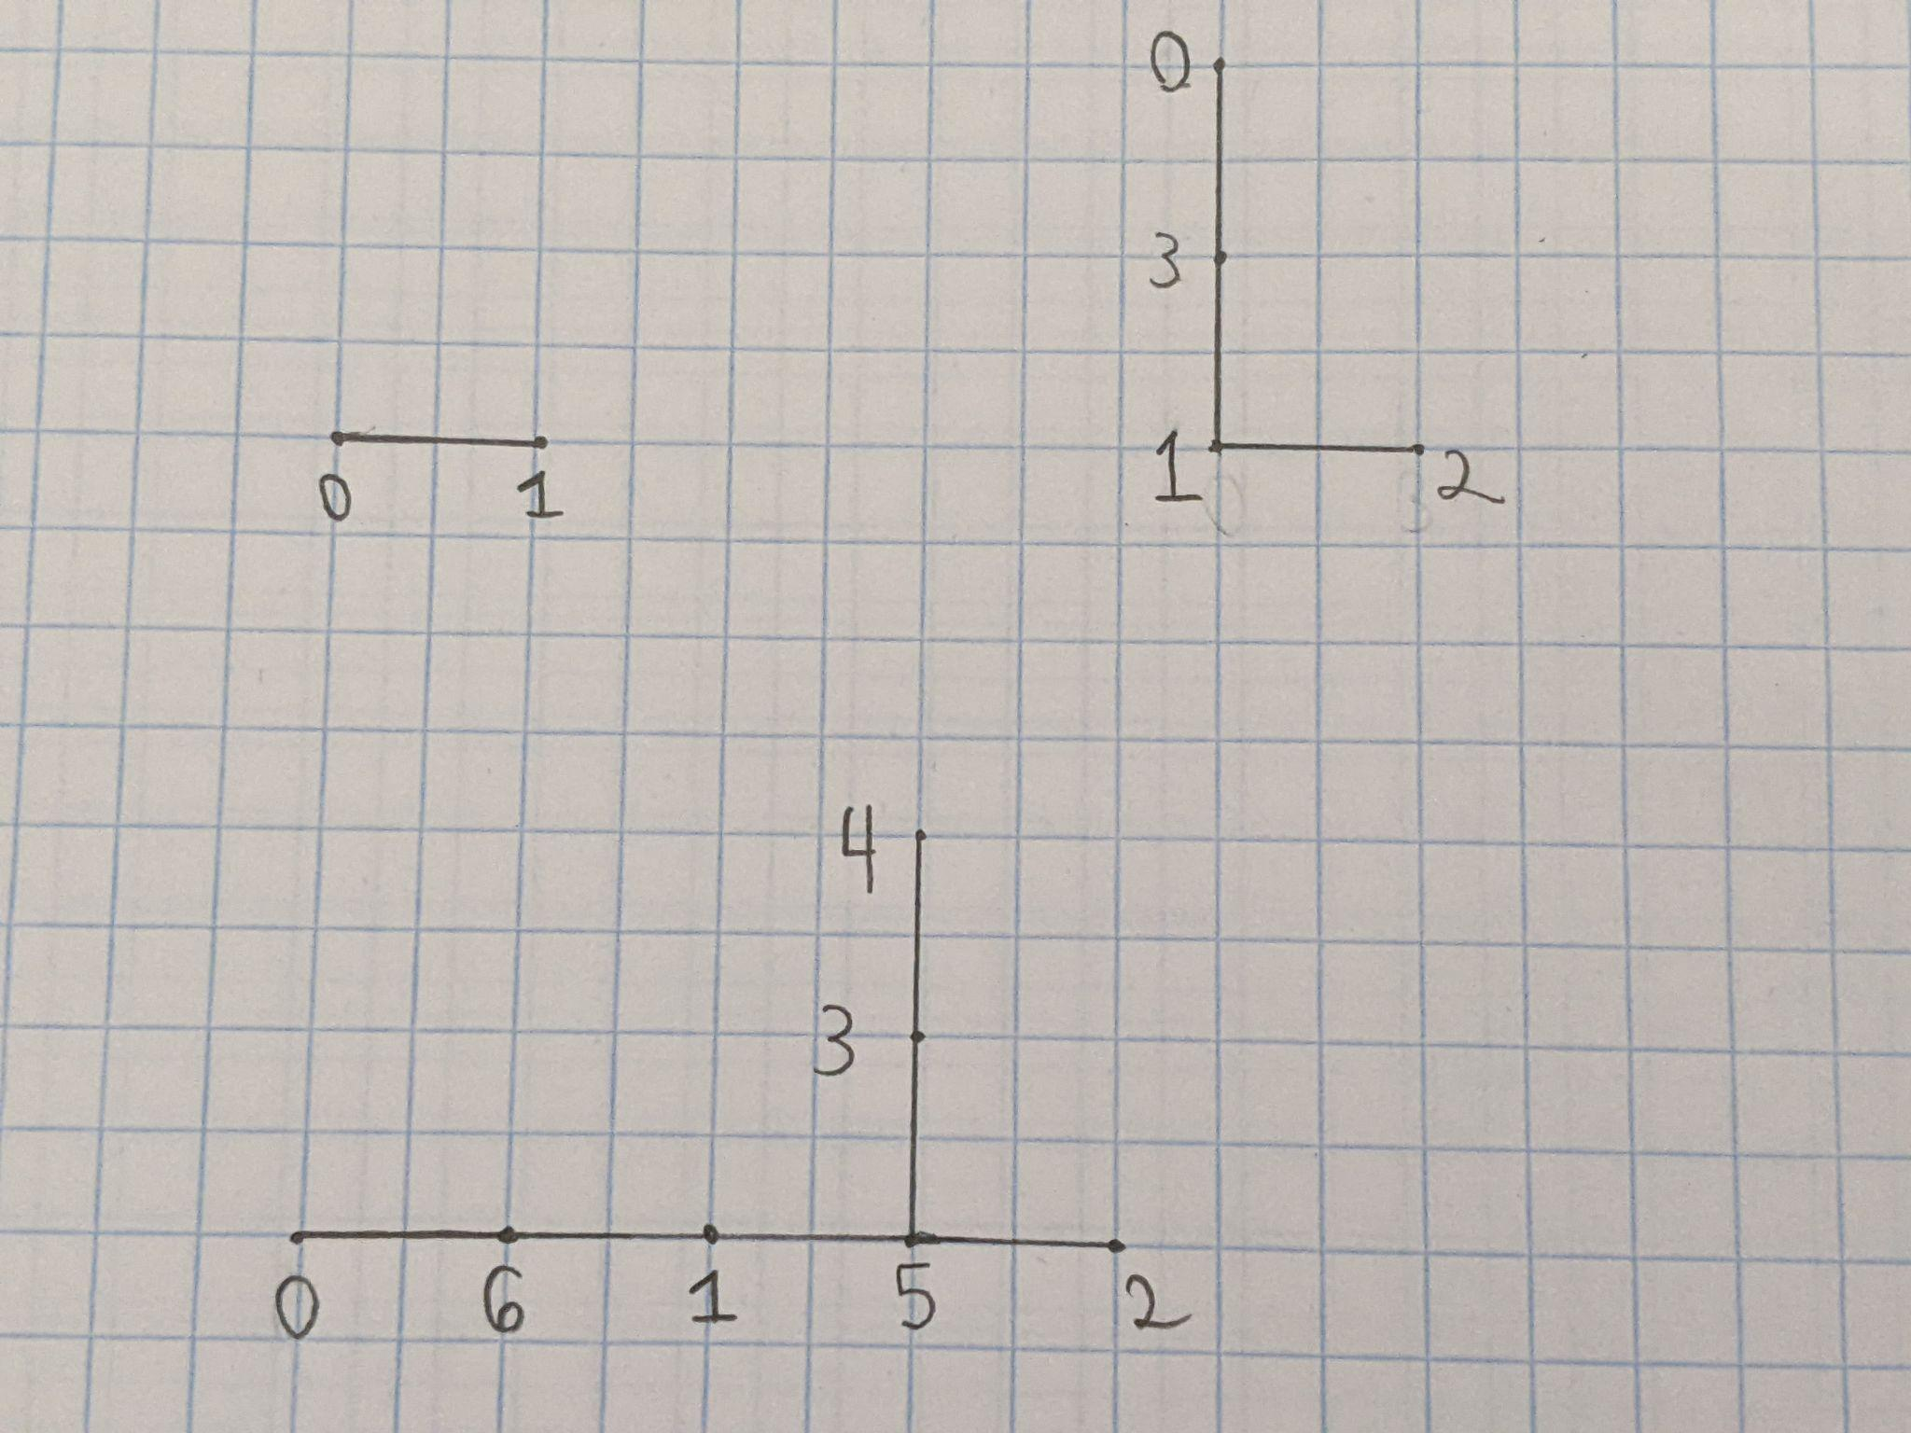
Olive Trees
Notes:
Here, we can see some of my first attempts to gracefully label olive trees (which are essentially the symmetrical trees that I was discussing earlier but with missing edges in ascending order). The first two graphs are basically path graphs. For the third graph, my heuristic is to essentially label the longest branch as I would label any path graph until I label the central vertex. After labeling the central vertex, I put either the highest or lowest remaining labels on the surrounding vertices, depending on whether the central vertex was labeled with a comparatively low or high number. Because the central vertex was labeled with 5 in this case (a comparatively high number), we label the surrounding vertices with the lowest remaining labels.

Slide 17
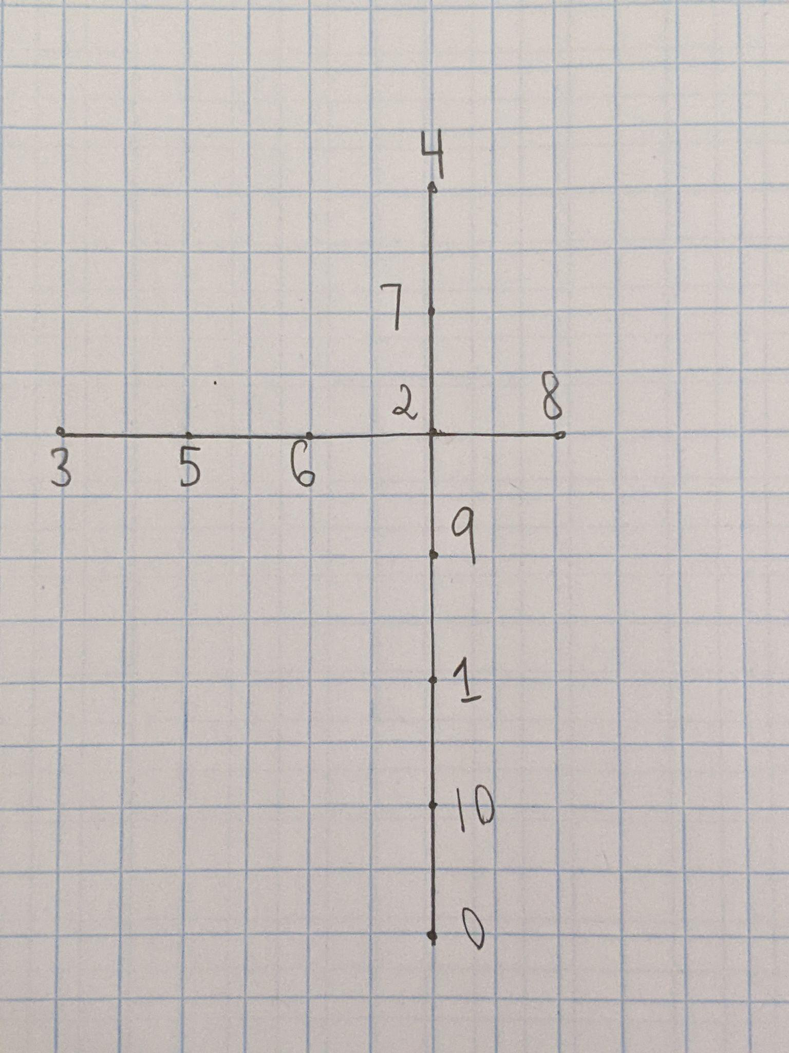
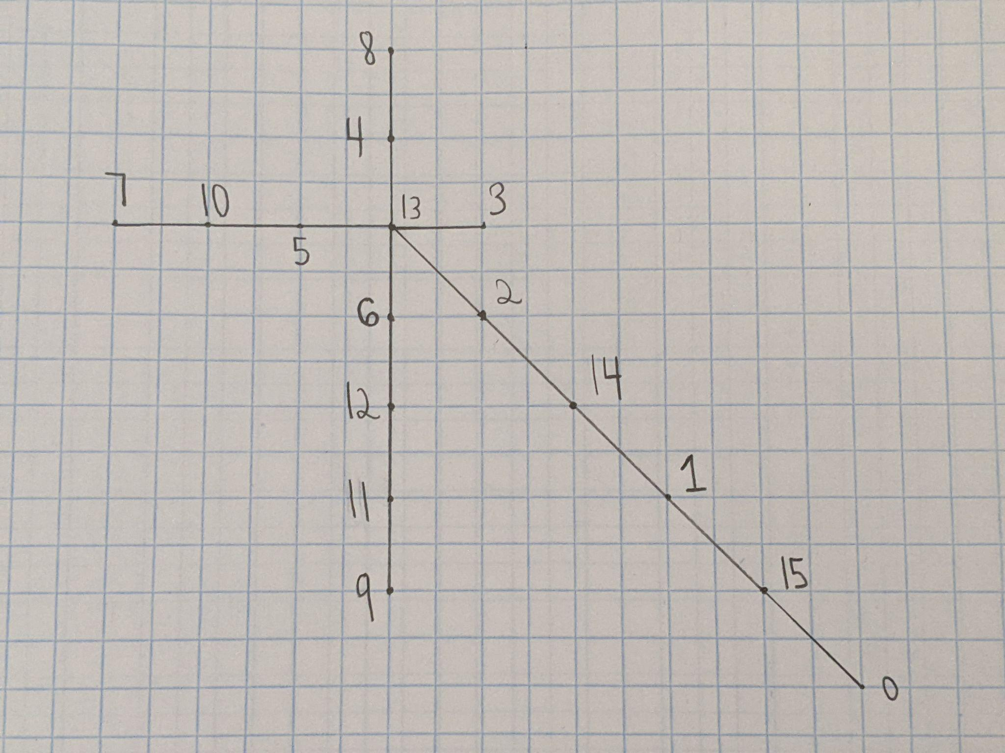
Olive Trees (Cont.)
Notes:
I was also able to gracefully label some more olive trees using the same heuristic, as can be seen in these images. These trees were somewhat more difficult to gracefully label because I only had a heuristic to label the longest branch and the vertices surrounding the central vertex, not the entire tree.

Slide 18
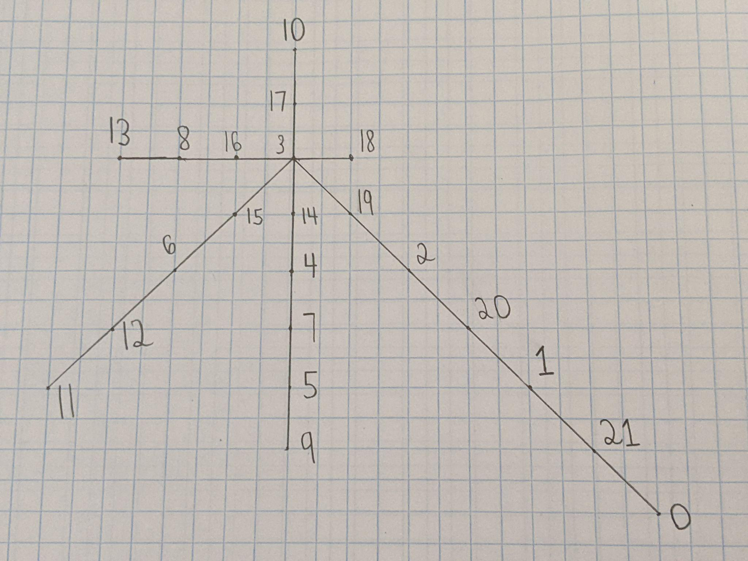
Olive Trees (Cont.)
Notes:
This was the last olive tree that I was able to gracefully label by using the same heuristic.

Slide 19
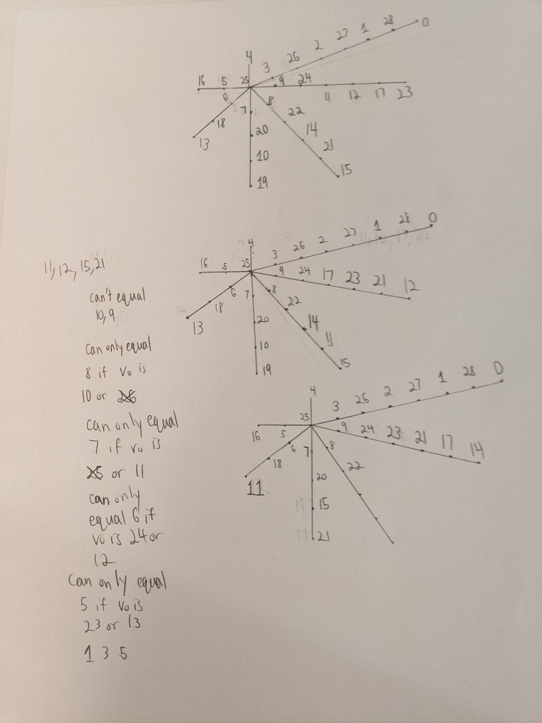
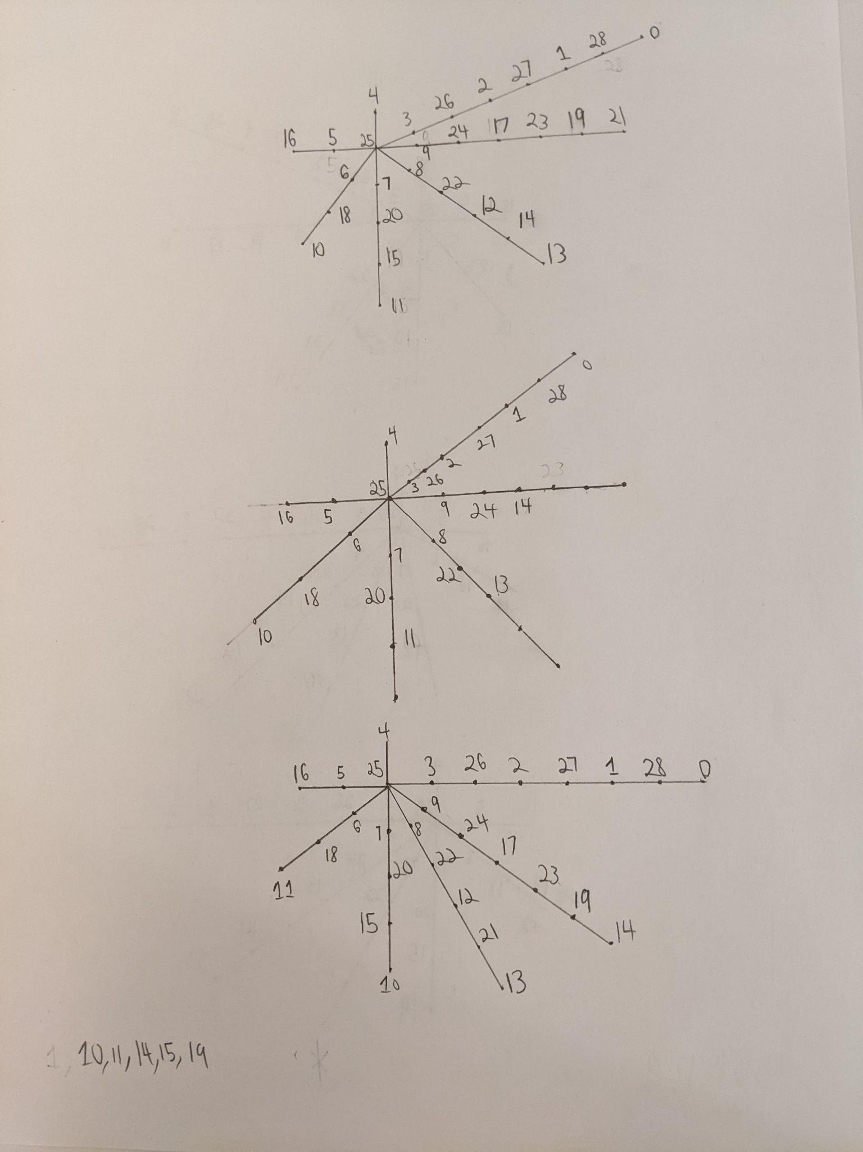
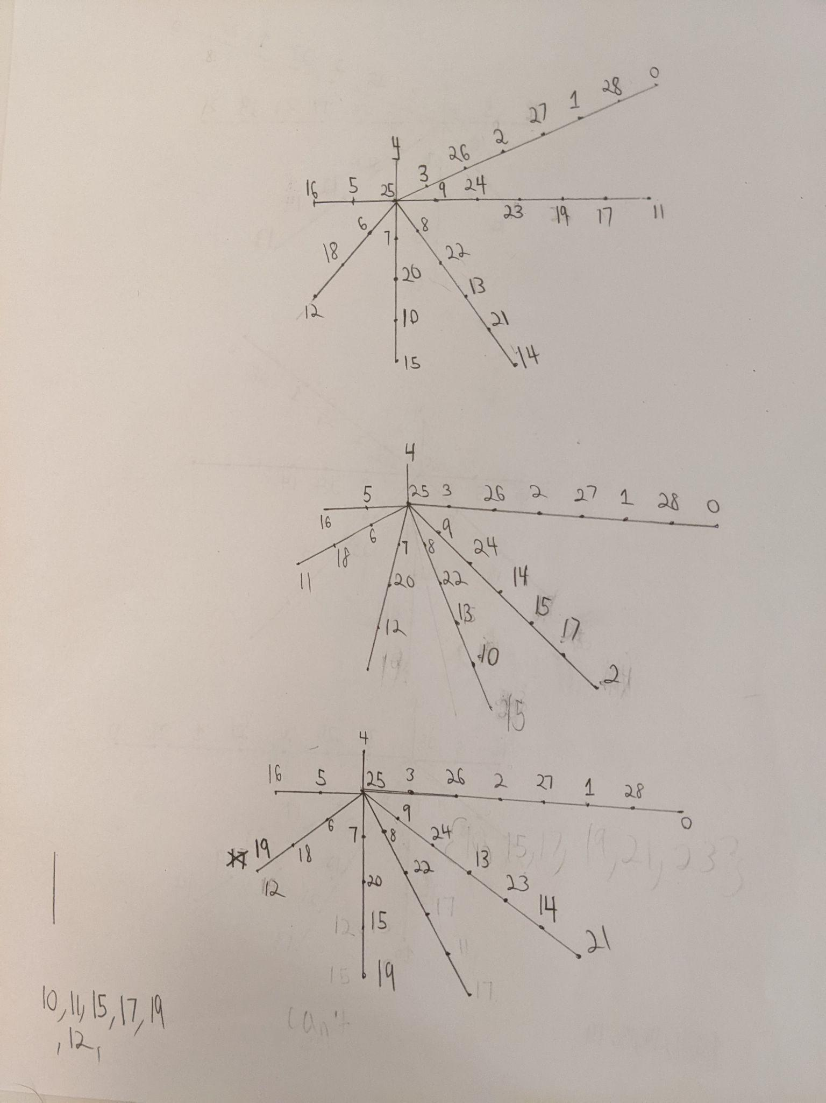
Olive Trees (Cont.)
Notes:
However, when I tried adding one more branch, I found that my general heuristic did not work. To see what I am referring to, we can examine all the images in this slide. These are all failed graceful labelings of olive trees with 29 vertices. In fact, I failed far more often than what is shown by these attempts because I would often re-erase my graphs and start over again. Sometimes, I would be able to ascertain that my method would not work before I even finished labeling the tree. I started to question if my heuristic was even correct.

Slide 20
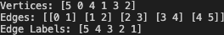
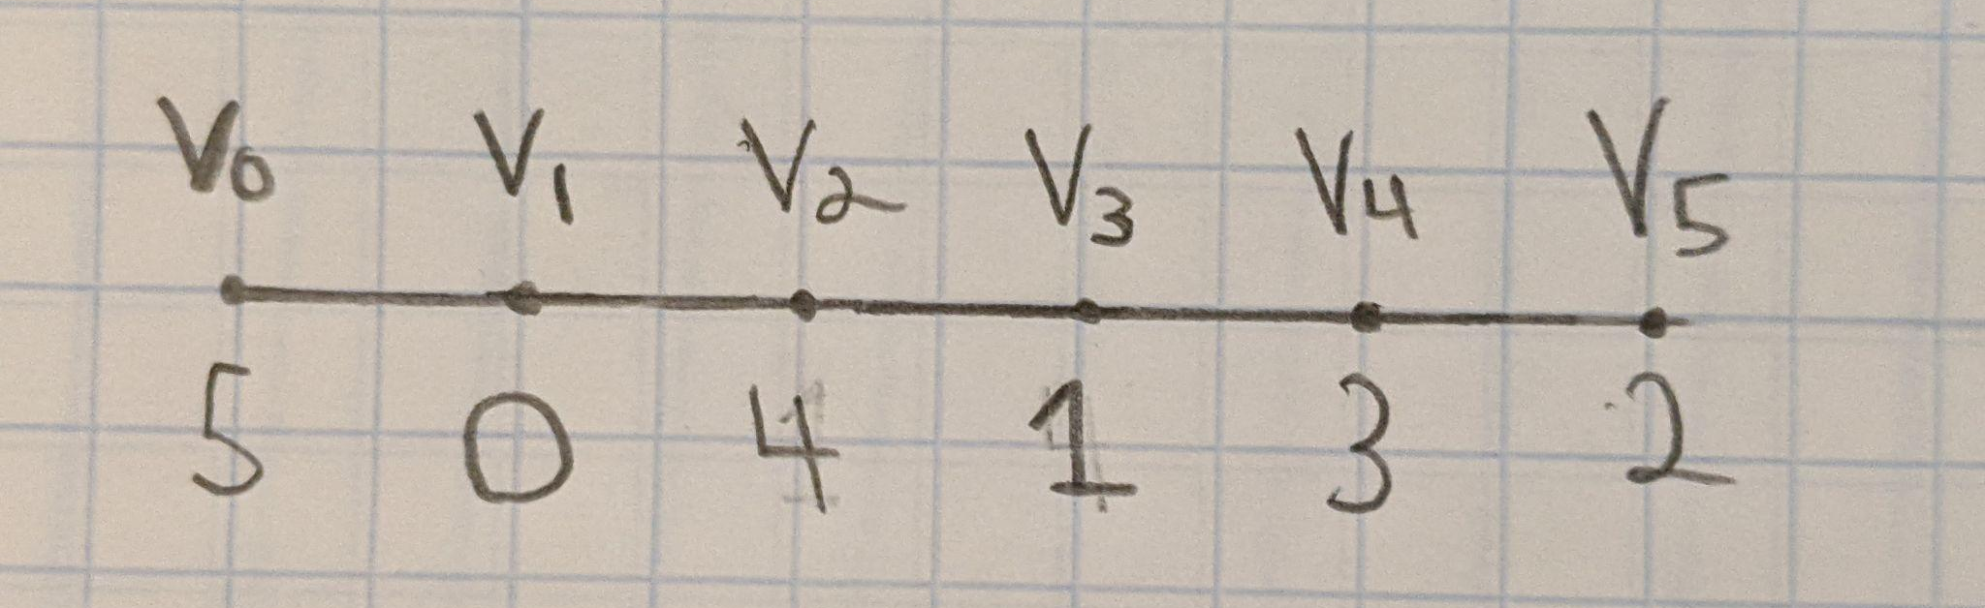
Programming
Notes:
In order to resolve this issue, I decided to write a program in Golang to gracefully label the olive trees. First, I wanted to ensure that my program could label simpler graphs, such as path graphs. An example of the computer output is shown in this slide. The numbers in the vertices array represent the labels of the vertices, and the indices of the vertices array represent the vertices themselves. The 2-dimensional edges array informs us which vertices (indices) are connected. Finally, the edge labels array contains all of the induced edge labels. If all the numbers in the edge labels array are distinct, then we know that we have obtained a graceful labeling. Because this output is difficult to decipher (even for me), I have attached an image of the corresponding path graph.

Slide 21
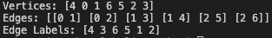
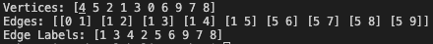
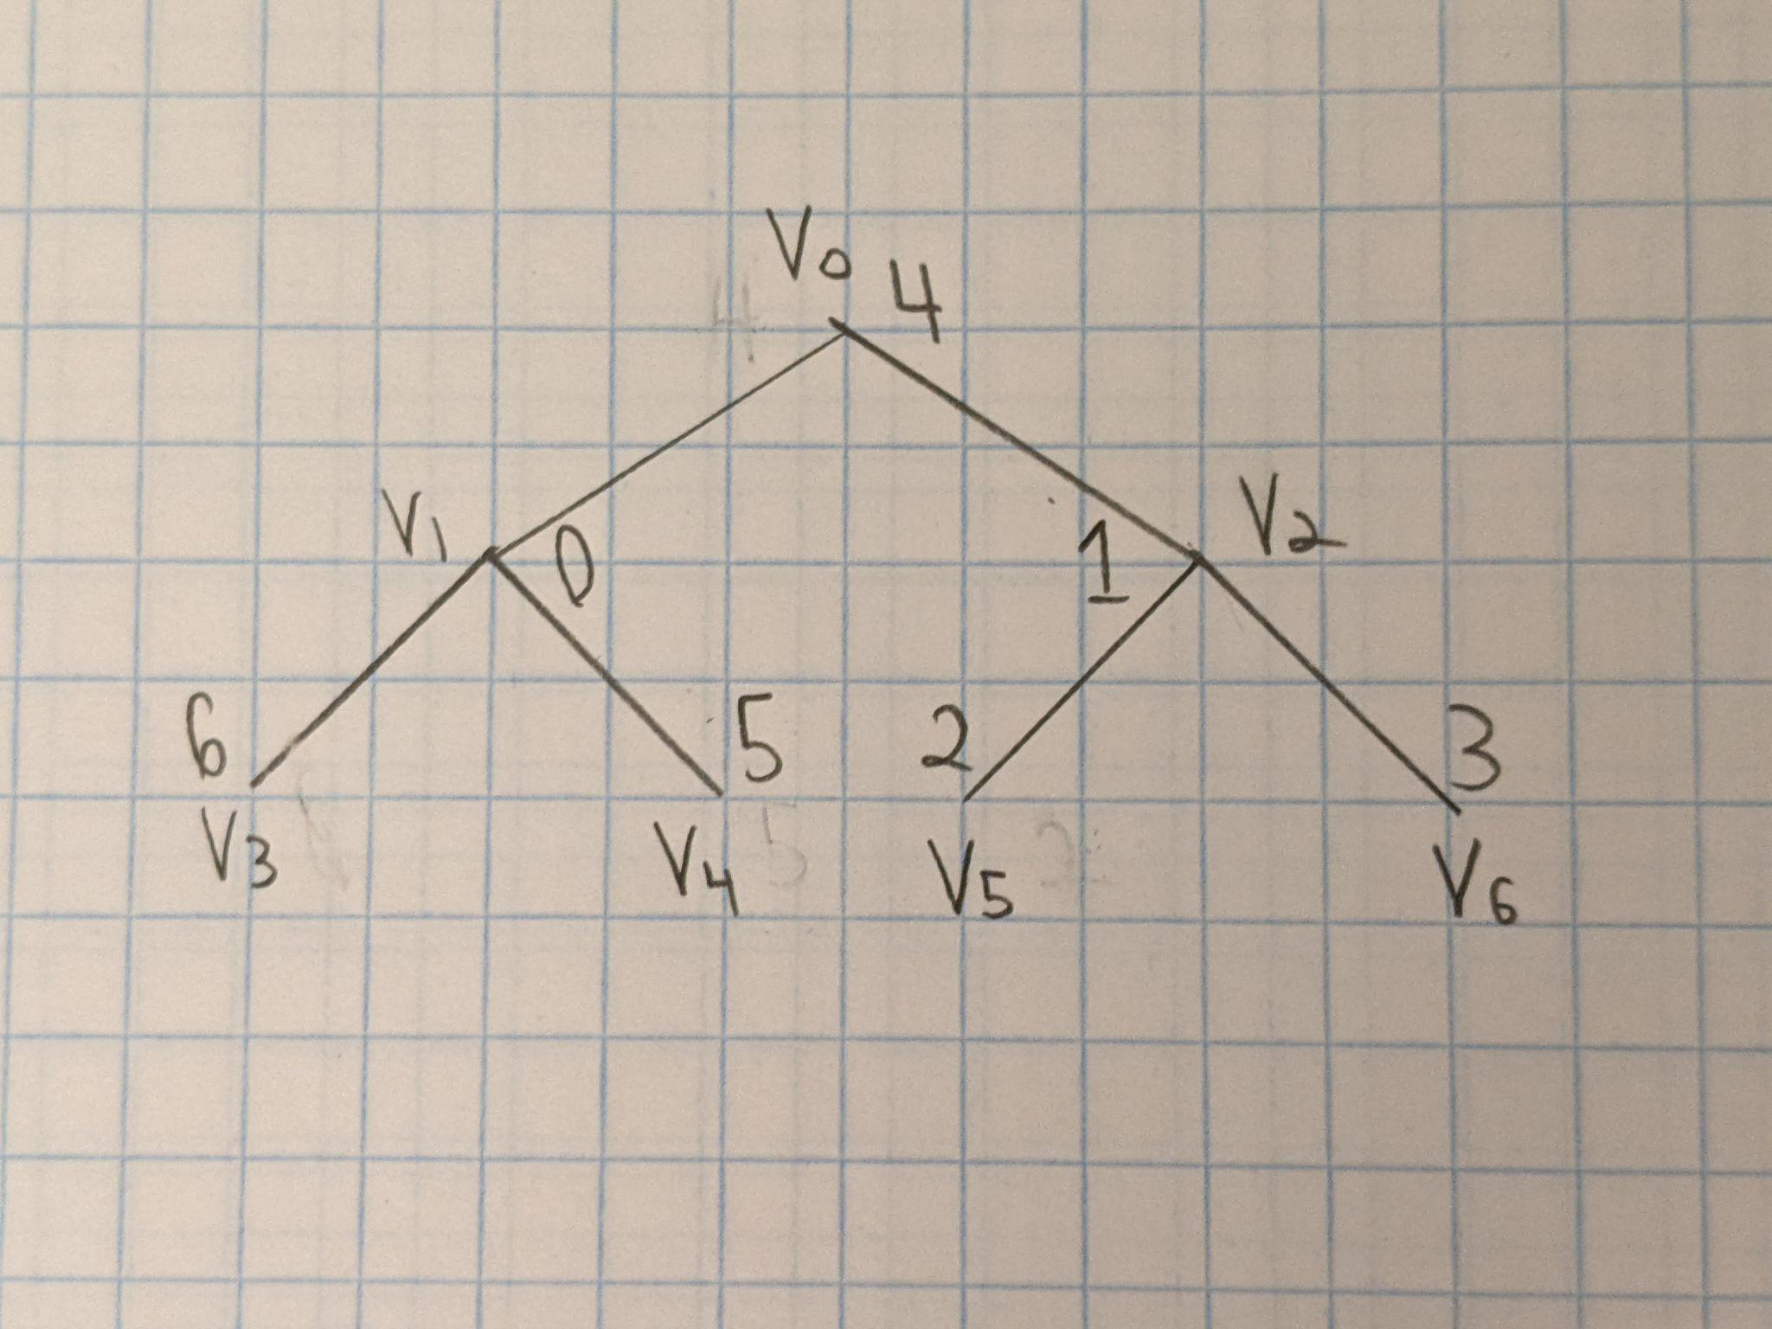
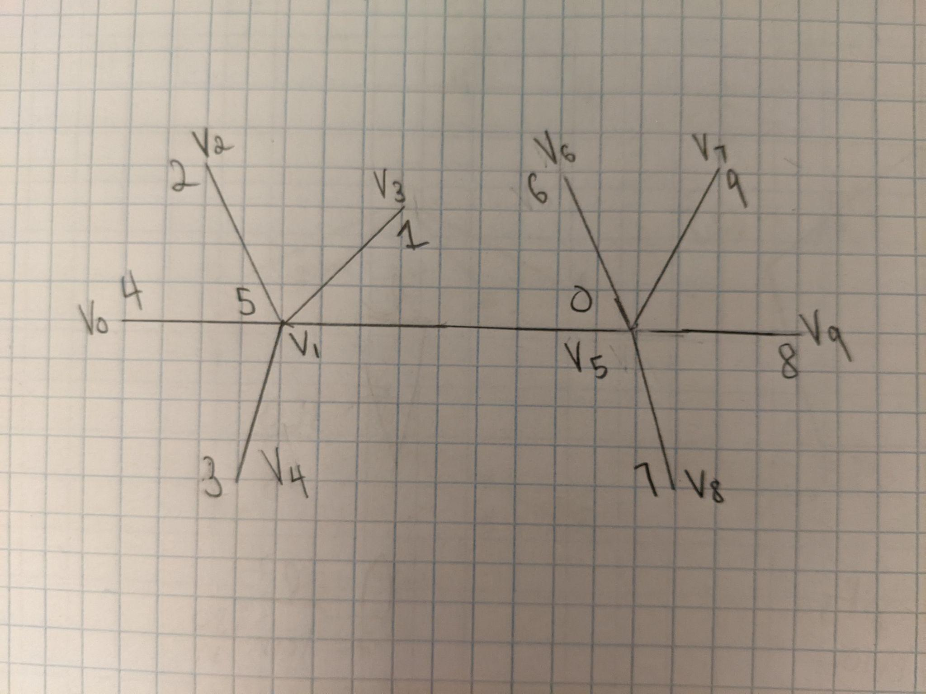
Programming (Cont.)
Notes:
I also utilized this program to label other types of graphs, such as binary trees and caterpillar graphs. The computer output and corresponding gracefully labeled graphs can be seen in the images on this slide.

Slide 22
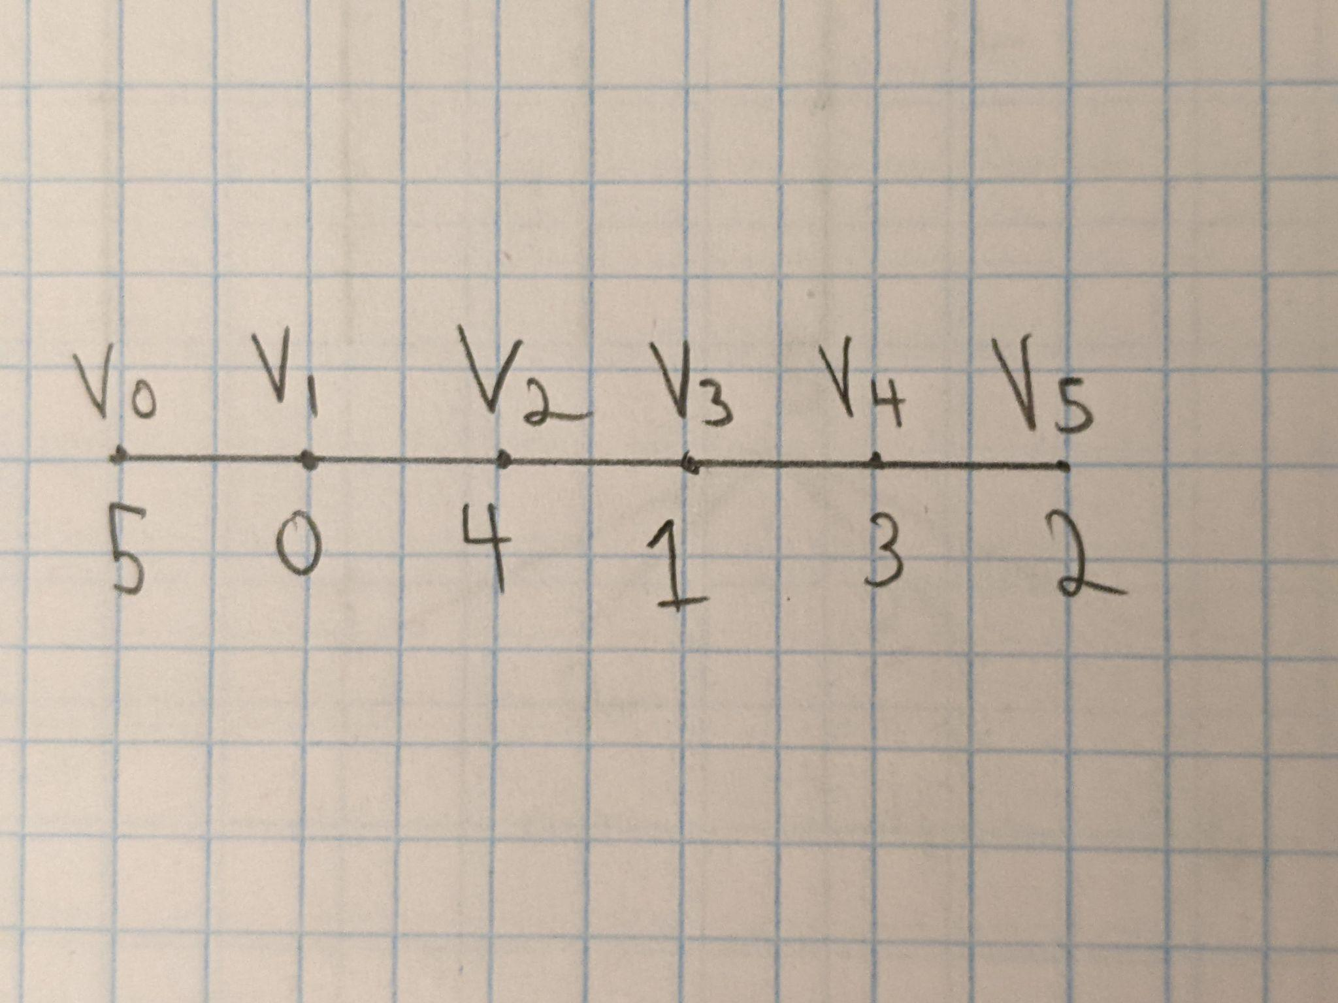
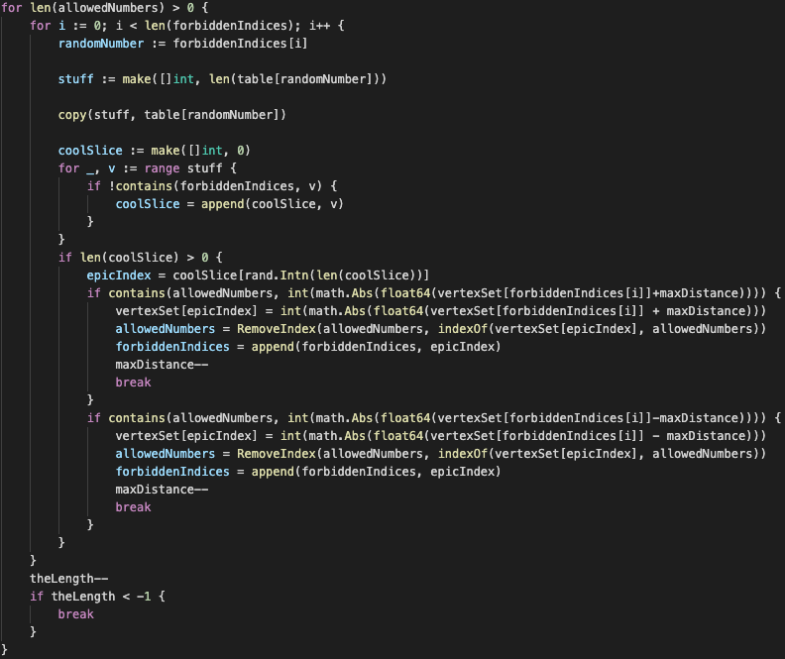
Programming (Cont.)
Notes:
So far, the computer was using brute force to find graceful labelings. However, this made the program extremely inefficient. To label the above path graph, the computer took approximately 2 minutes. Furthermore, the number of potential labelings grows factorially. Therefore, I had to optimize my program if I wanted it to label an olive tree with 29 vertices. To see how I optimized this program, we can examine the above path graph and computer code. When I attempt to gracefully label trees, I first place the highest and lowest vertex labels on adjacent vertices to ensure that I obtain the highest edge label first. Furthermore, I attempt to obtain all of the edge labels in descending order. This is because I am trying to create a surjection between the set of edges and the set of edge labels. Because the set of edges and the set of edge labels are both finite and have the same cardinality, having a surjection between them means that we have an injection between them, which is essentially the definition of graceful labeling. Let us examine the above path graph. First, the computer happened to label the leftmost vertex with a 5. In this case, I would realize that I have to label the vertex v_1 with 0 in order to obtain the edge label of 5. In order to obtain the edge label of 4, I only have two options: I can either label a vertex adjacent to 5 with 1, or I could label a vertex adjacent to 0 with 4. Because all of the vertices adjacent to 5 have already been labeled, I am forced to label the vertex adjacent to 0 with a 4 in order to obtain the edge label of 4. Similar reasoning informs us that we must label the vertex v_3 with 1 and so on. Although this is trivial for humans to understand, it is incredibly difficult to implement this logic into a computer program. The above code represents my attempt to do so.

Slide 23
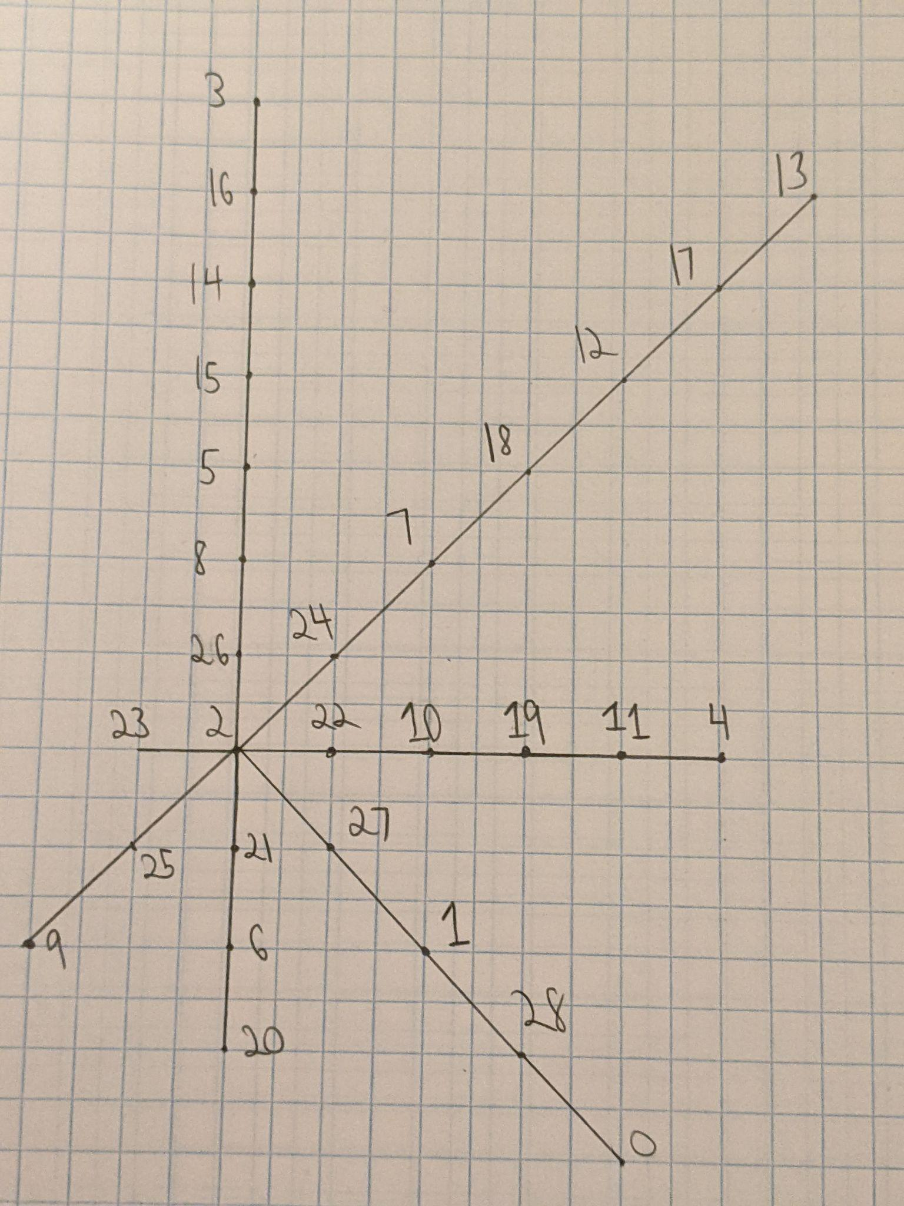
Programming (Cont.)
Notes:
Surprisingly, the optimized program actually managed to gracefully label the olive tree with 29 vertices. Furthermore, it used a method that was similar to my initial heuristic, where it labeled one of the branches (not necessarily the longest one) as I would label a path graph, and it placed the highest remaining vertex labels around the central vertex (which was labeled with 2). However, I was not really able to spot any further patterns than this. Also, I wanted to see how far I could push the program, so…

Slide 24
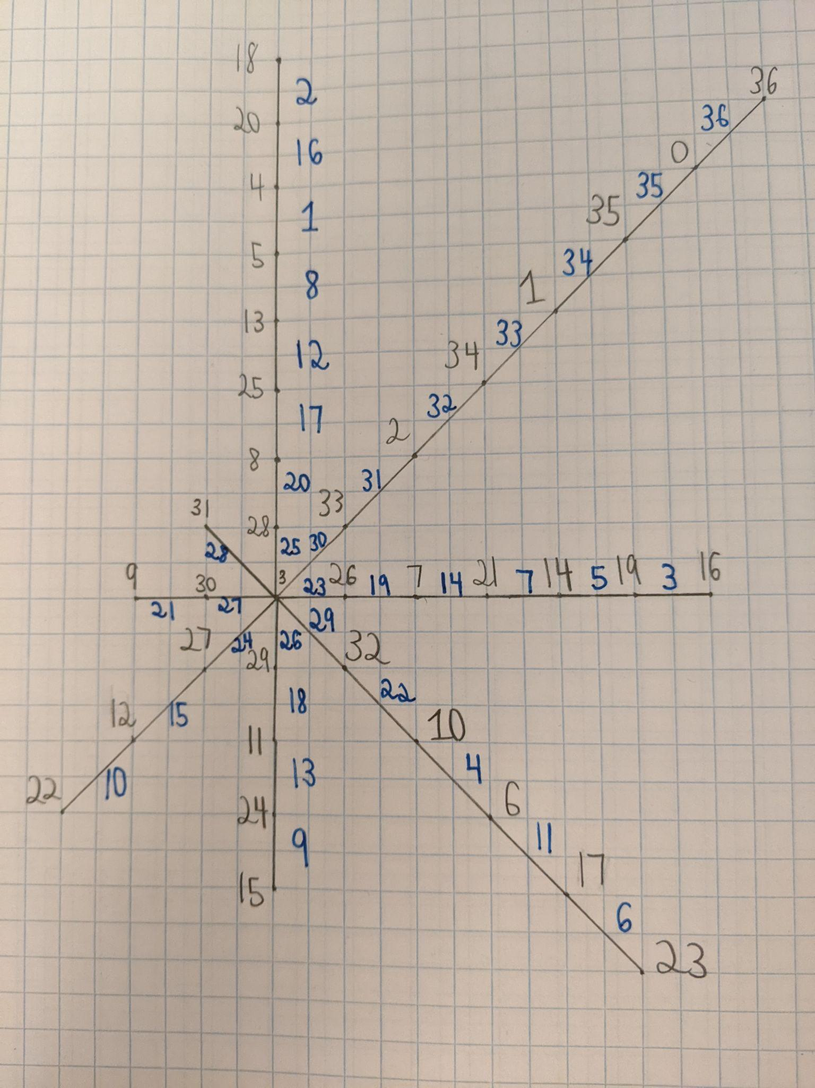
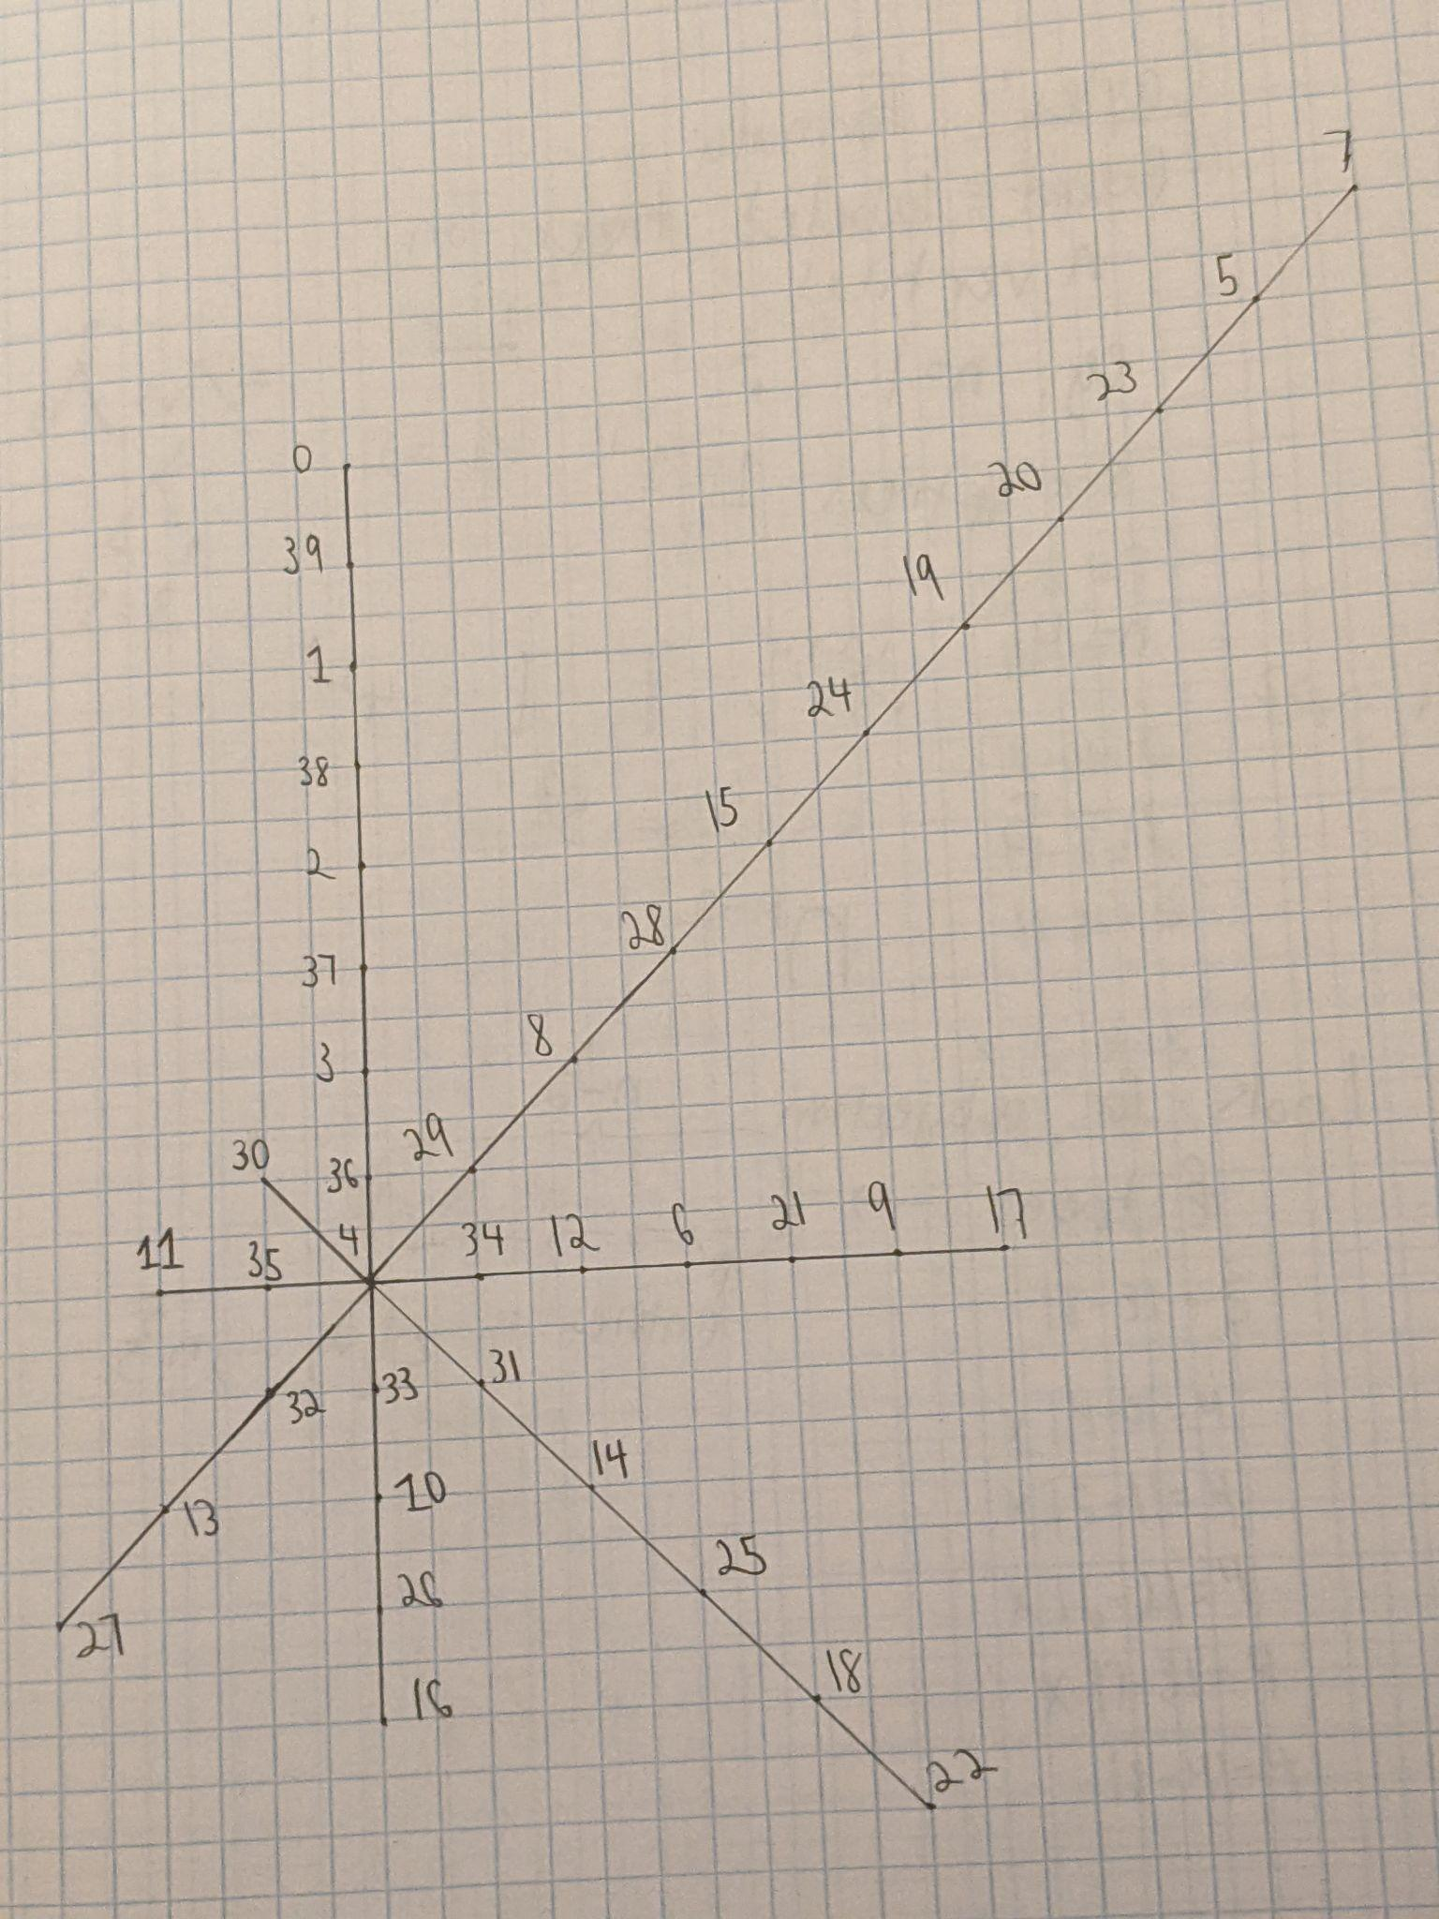
Programming (Cont.)
Notes:
I also tried this computer program on olive trees with 37 and 40 vertices, and it finished gracefully labeling each of them after running for 10 minutes. On the leftmost graph, I wrote the induced edge labels in blue ink in order to ensure that I had actually obtained a graceful labeling. On the rightmost graph, I simply added 3 more vertices to the end of one of the branches. The patterns that the computer found are somewhat similar to my heuristic, but I have not yet found a general method for gracefully labeling olive trees.

Slide 25
Future Work
Optimize my program further.
Systematically gracefully label olive trees.
Utilize the program for other types of graphs.
Notes:
First, I believe that I should optimize my program further because Golang has concurrency, which I have not really utilized yet. Also, I was thinking that I could hardcode some vertex labels based on what seemed to work for the olive trees. In fact, I have researched some algorithms that are far more efficient than the one used in my program. If these algorithms were rewritten in Golang, we might be able improve the upper bound on the number of vertices such that all trees with that number of vertices can be gracefully labeled (which is currently 35). I should also ascertain a general method to gracefully label olive trees. Finally, I could use this program for other types of trees or maybe even other graphs.

Slide 26
References
https://dsc.duq.edu/cgi/viewcontent.cgi?article=1625&context=etd
http://sharif.edu/~eshghi/Graceful%20Graphs-Final%20Edition-89-12-15.pdf
https://citeseerx.ist.psu.edu/viewdoc/download?doi=10.1.1.70.7834&rep=rep1&type=pdf
https://www.quantamagazine.org/mathematicians-prove-ringels-graph-theory-conjecture-20200219/
https://github.com/ethanjan/betalabeling/
Notes:
Here are the references (which are essentially university links) for anyone who is interested. I could also send you the slides. The last link represents the github code, which is very poorly written. https://github.com/ethanjan/betalabeling/blob/main/main.go

